Slide 1
Learning trajectories from scRNA-seq data
Machine Learning for Single Cell Analysis

Slide 2
Goals for this unit
Understanding pseudotime
Comparison of diffusion and
Calculating distances between points
Introduction to the Numpy / Scipy / Pandas / Sklearn ecosystem

Slide 3
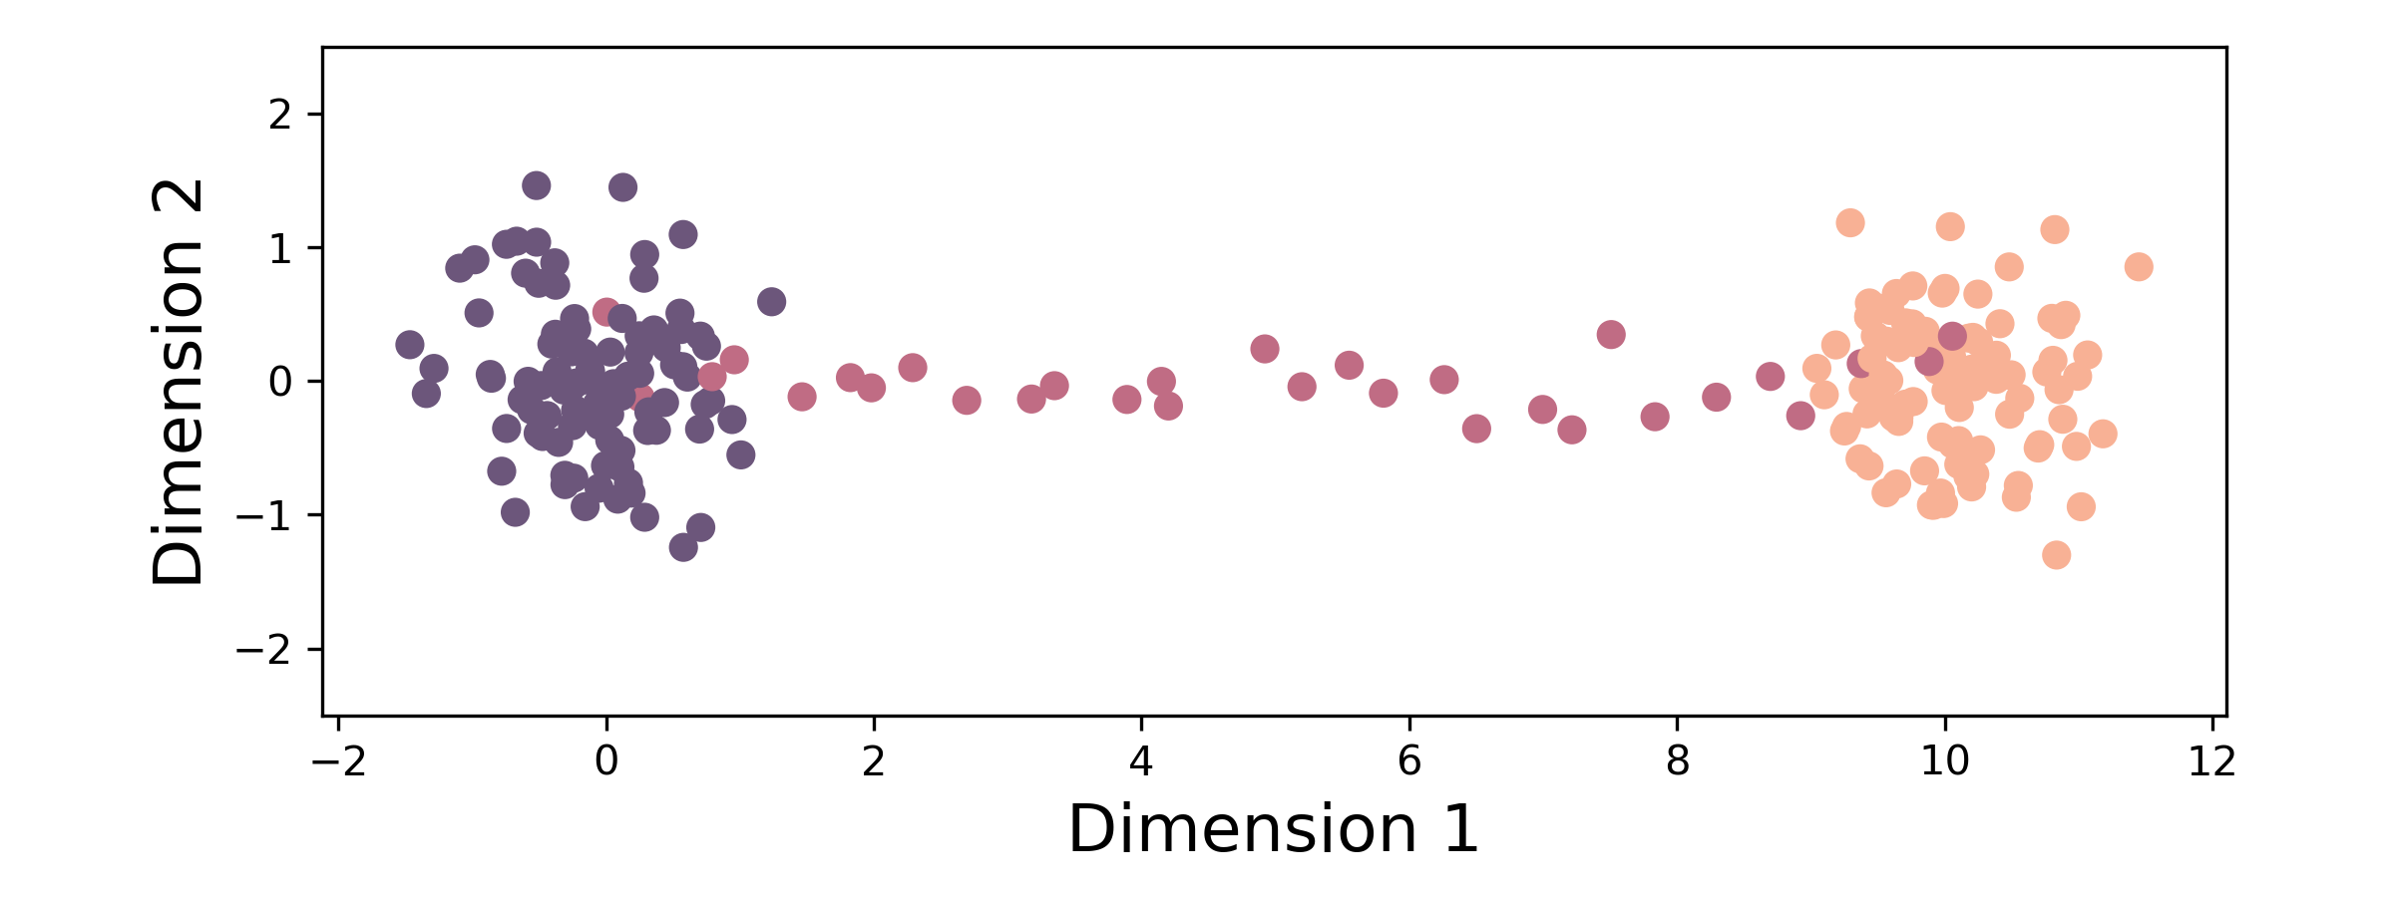
A simple developmental system
State 1
Intermediate
State 2
Dimension 1: “Genes that change from State 1 to State 2”
Dimension 2: “Noise genes”

Slide 4
A simple developmental system
State 1
Intermediate
State 2
Things we might like to know:
What genes are expressed in each population?
What genes change the most from State 1 -> State 2?
What is the ordering of gene expression?
How do gene-gene relationships change across states?

Slide 5
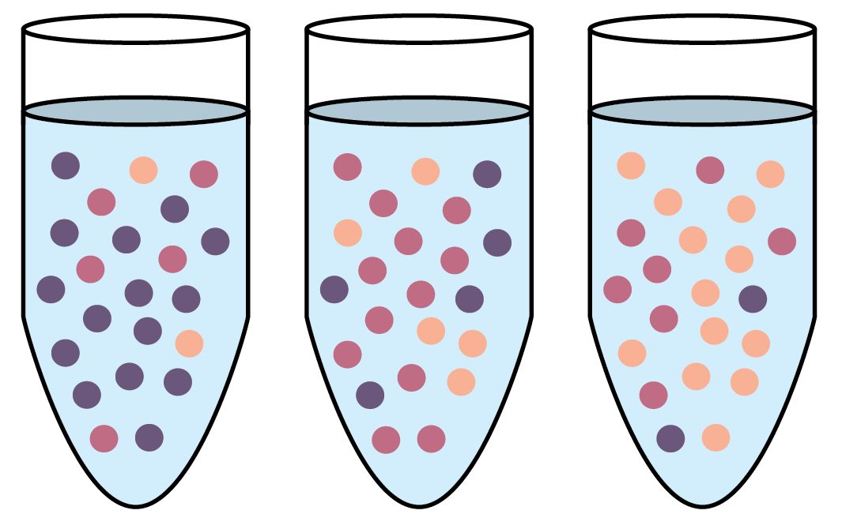


A simple developmental system
State 1
Intermediate
State 2
Sample at
1, 2, 3 days
+
Cells
Growth
Factor
1d
2d
3d

Slide 6
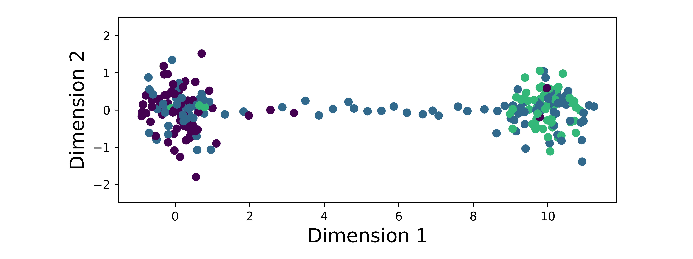
We must infer underlying biology from experimental observations
State 1
Underlying biology
Intermediate
State 2
Day 1
Experimental
data
Day 2
Day 3

Slide 7
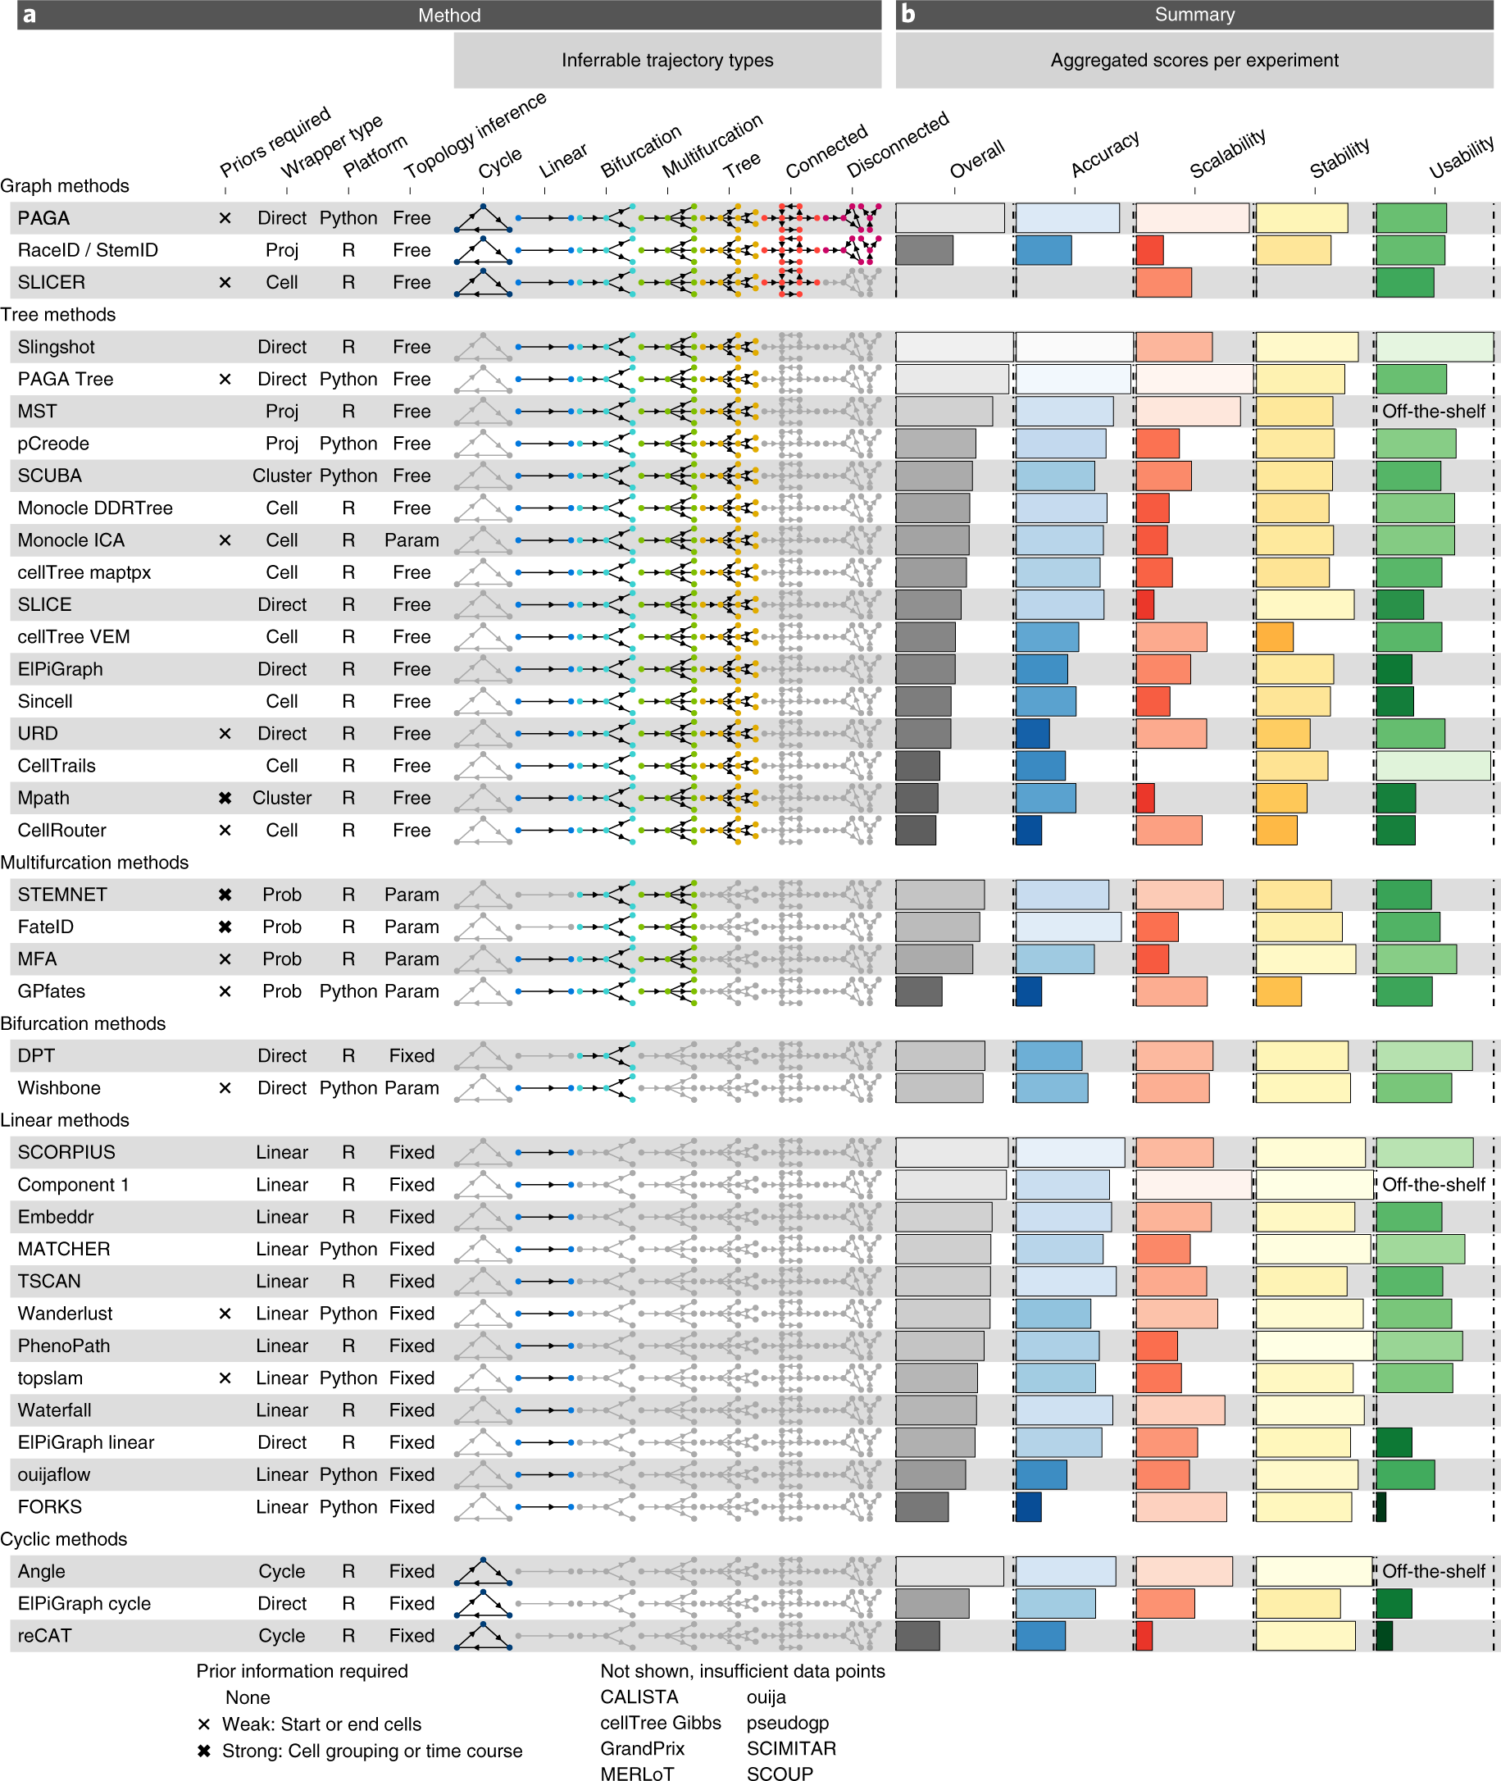
The goal of trajectory inference (TI) is to infer a temporal ordering of cells
Summary of 45 TI methods
dynverse.org

Slide 8
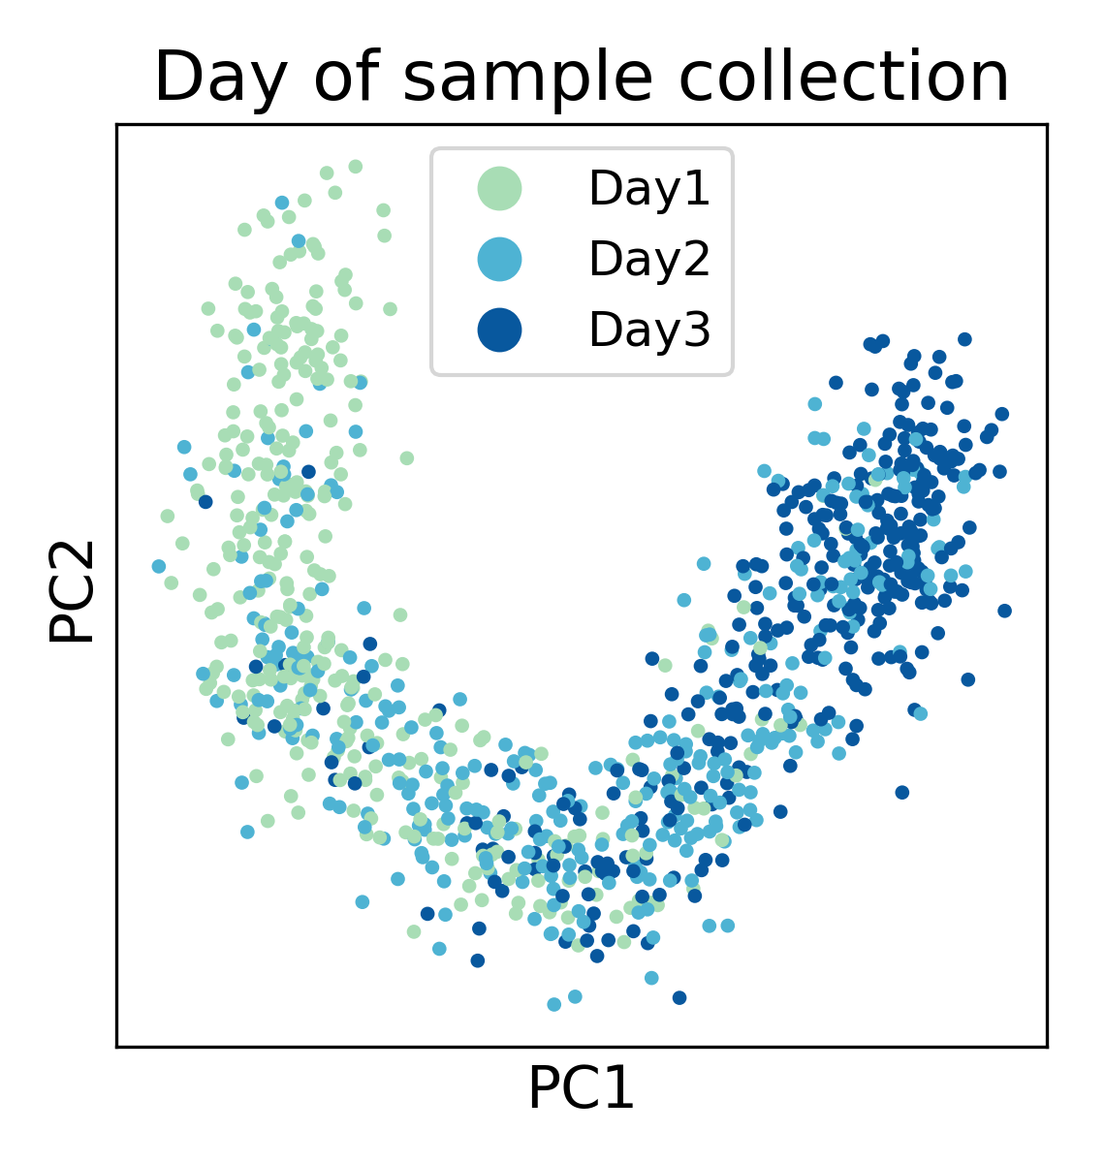
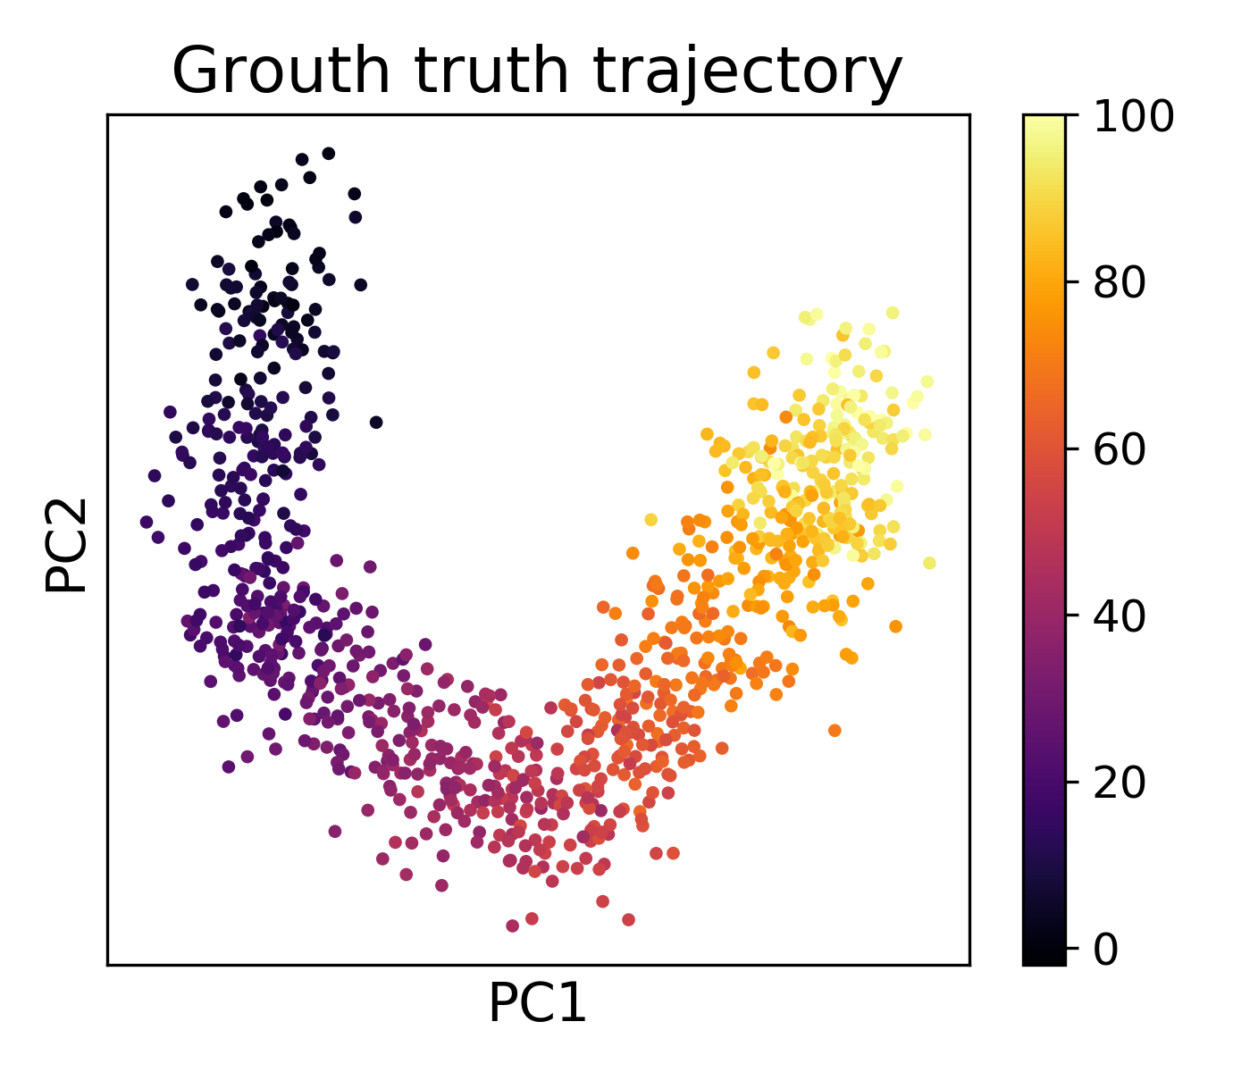
Learning pseudotime via graph walks

Slide 9
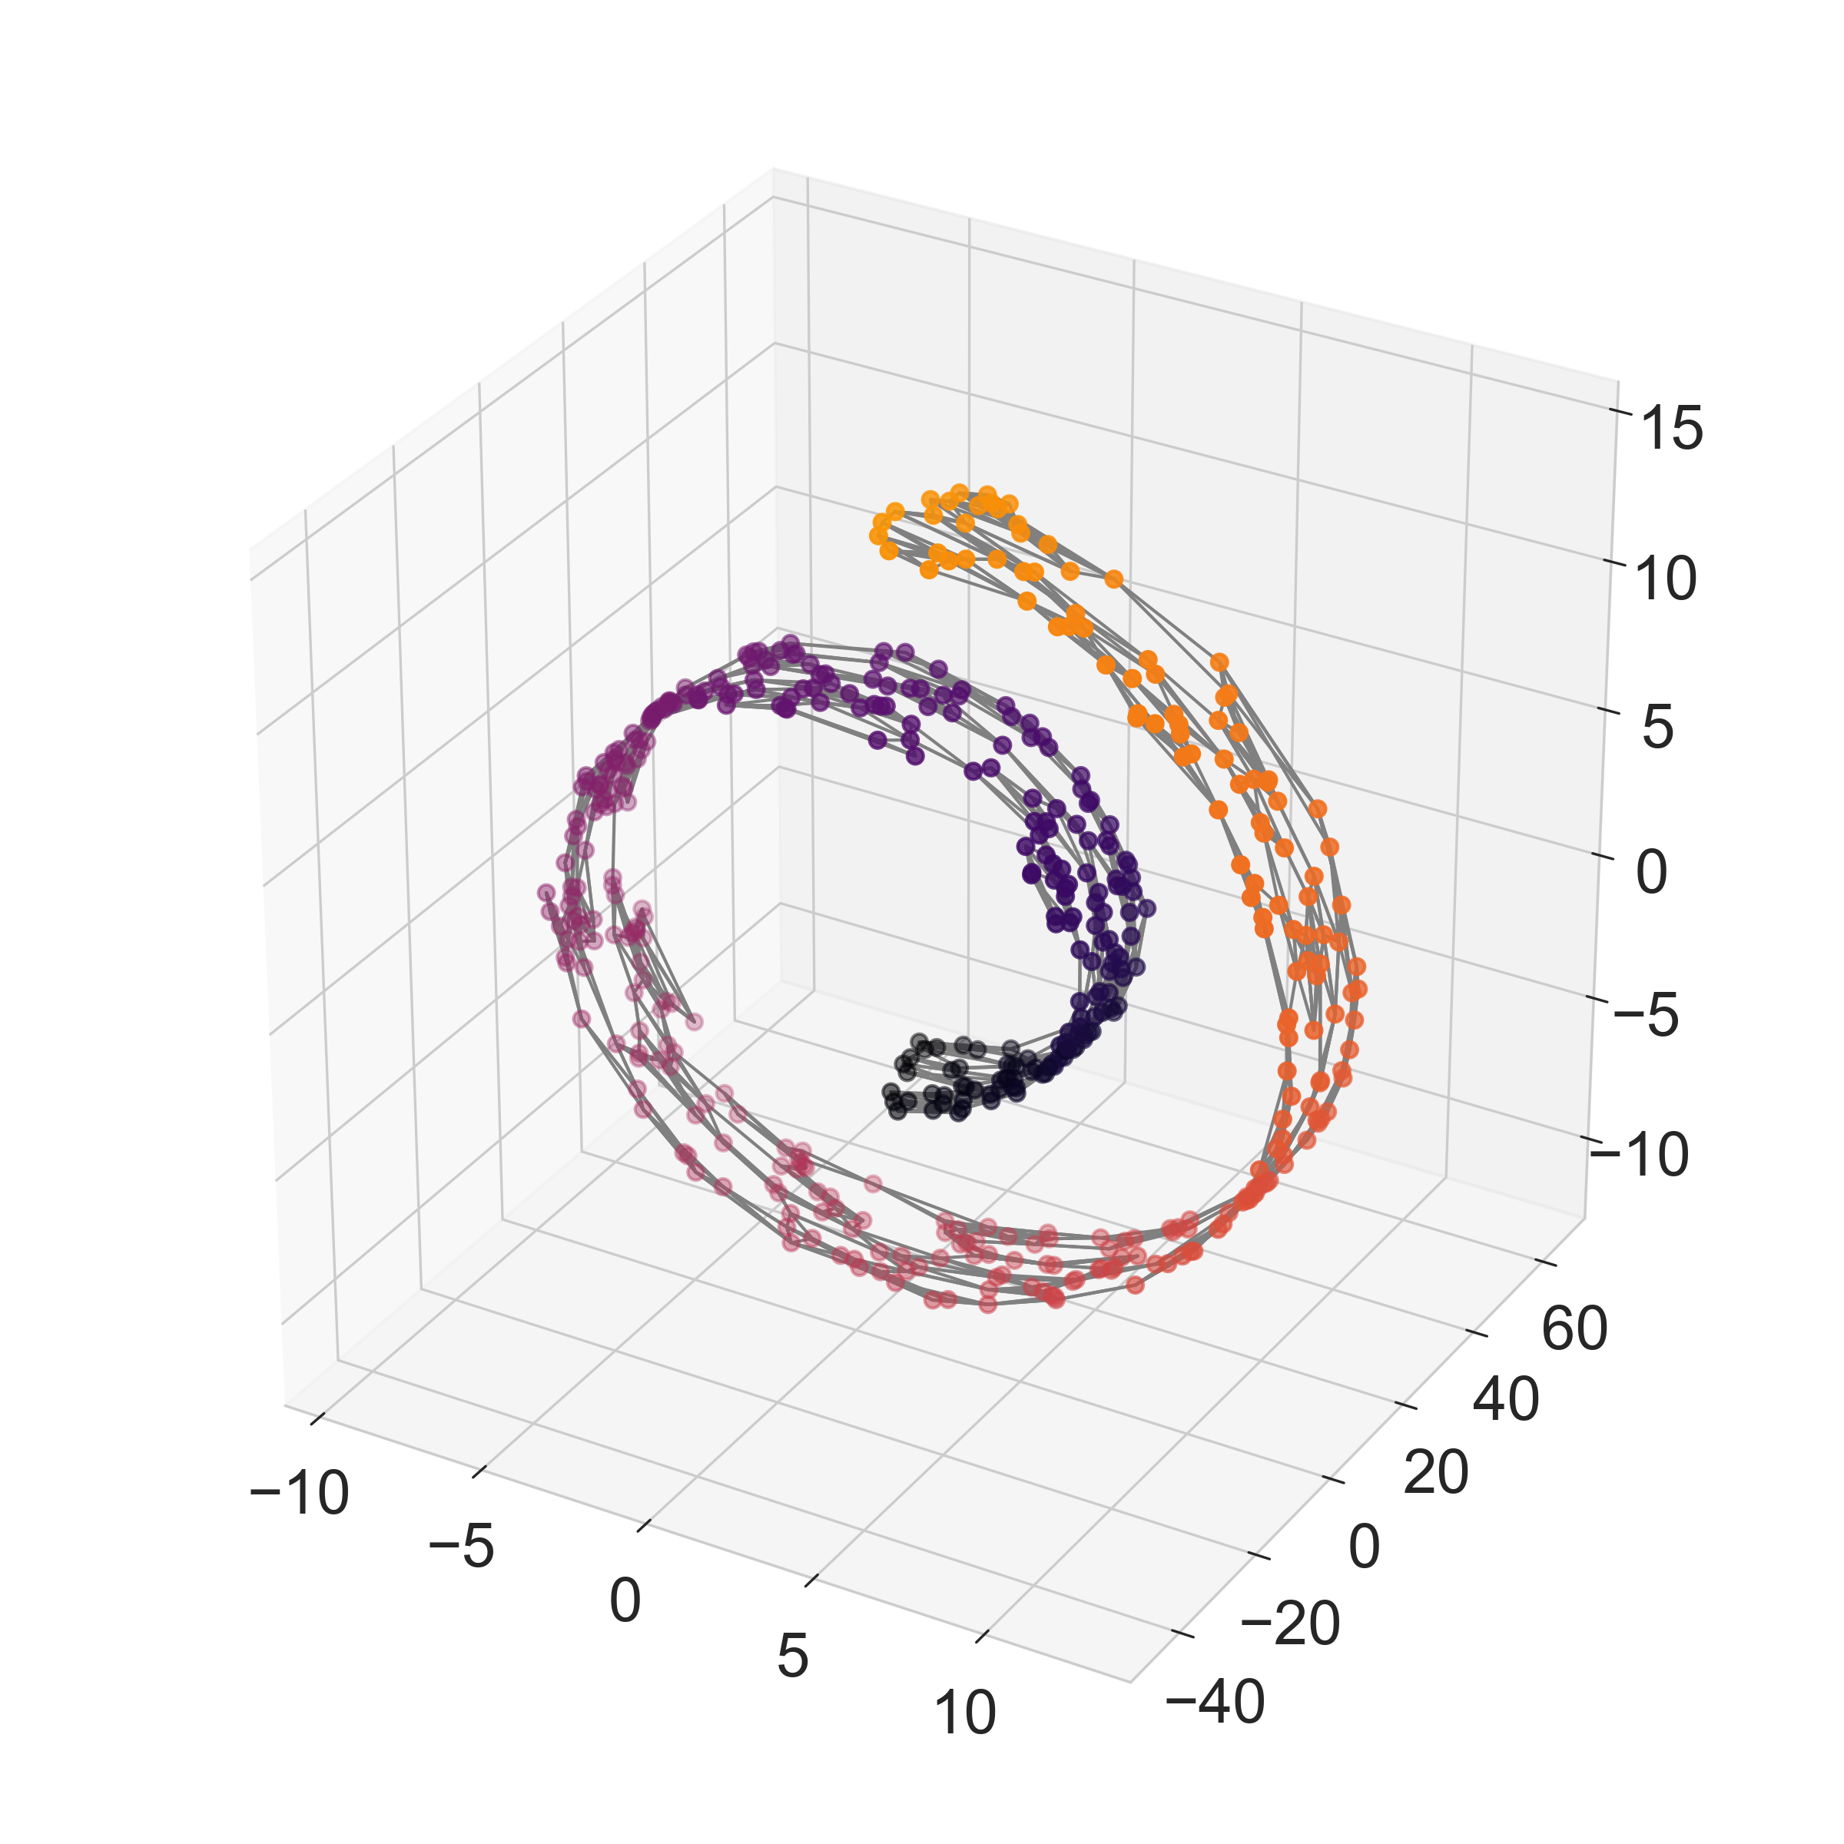
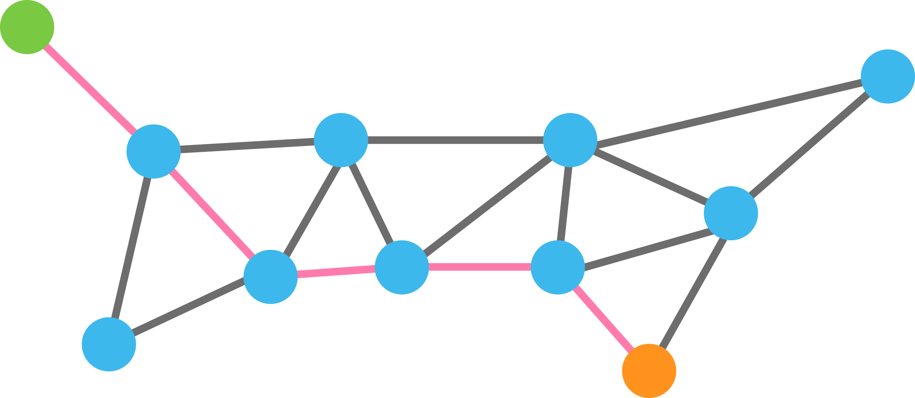
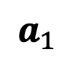
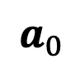
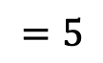
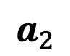
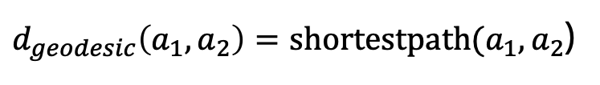
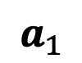
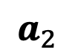
Graph walks approximate manifold distances
Shortest path between points
$$a_{1}$$
$$a_{0}$$
$$a_{1}$$
$$a_{2}$$
$$a_{2}$$
$d_{geodesic}\left(a_{1},a_{2}\right)=shortestpath(a_{1},a_{2}$)
$$=5$$

Slide 10
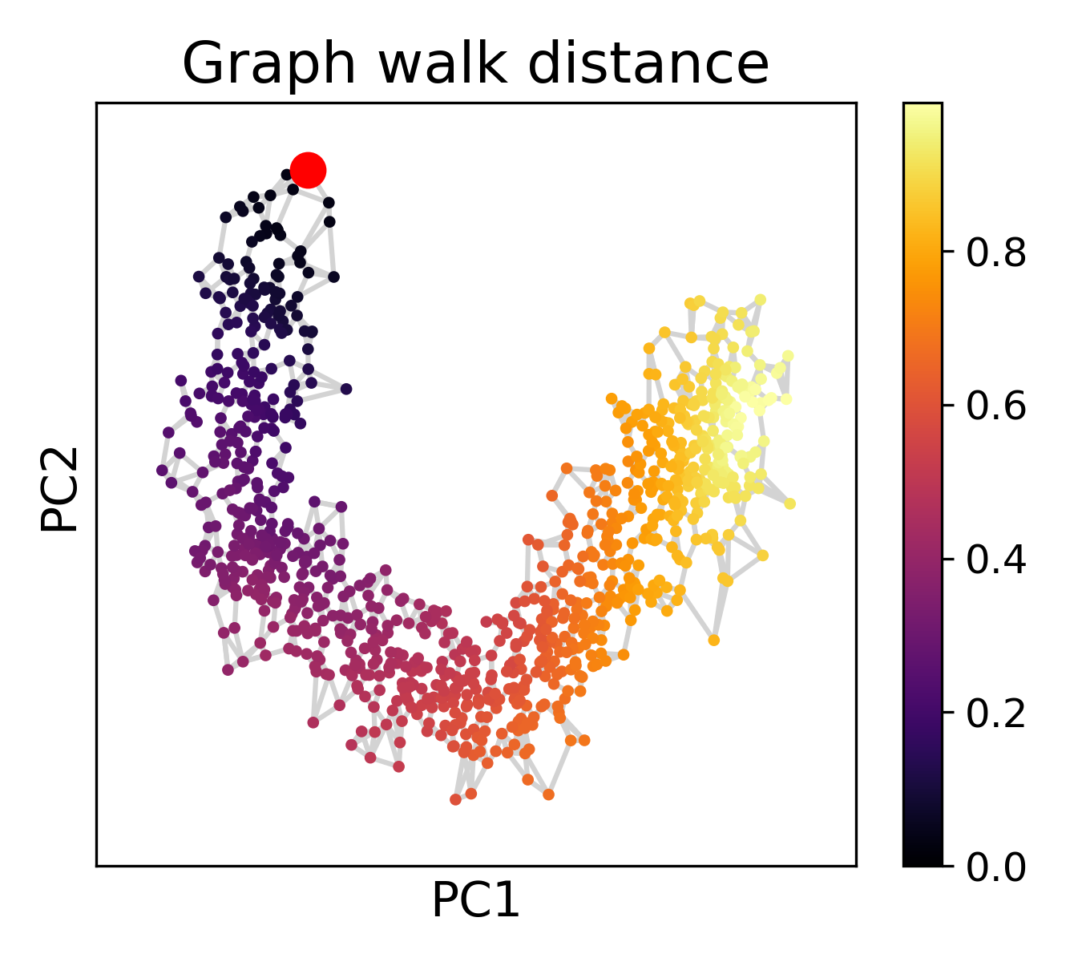
Learning pseudotime via graph walks

Slide 11
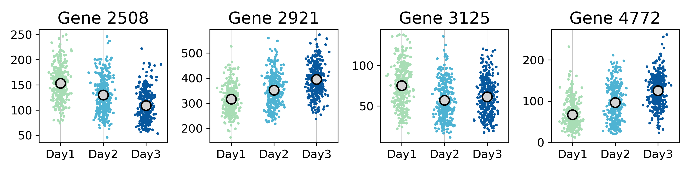
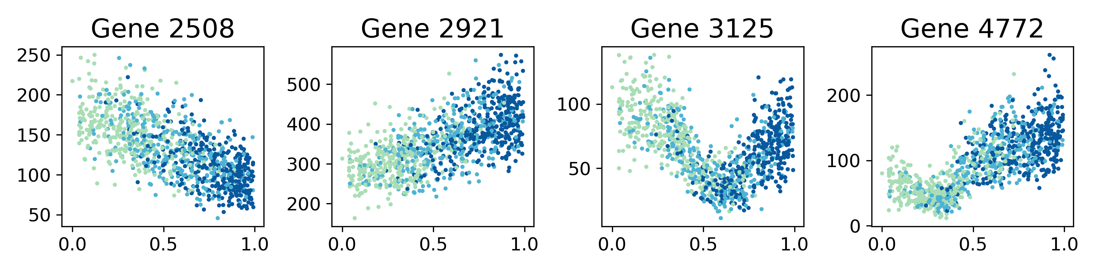
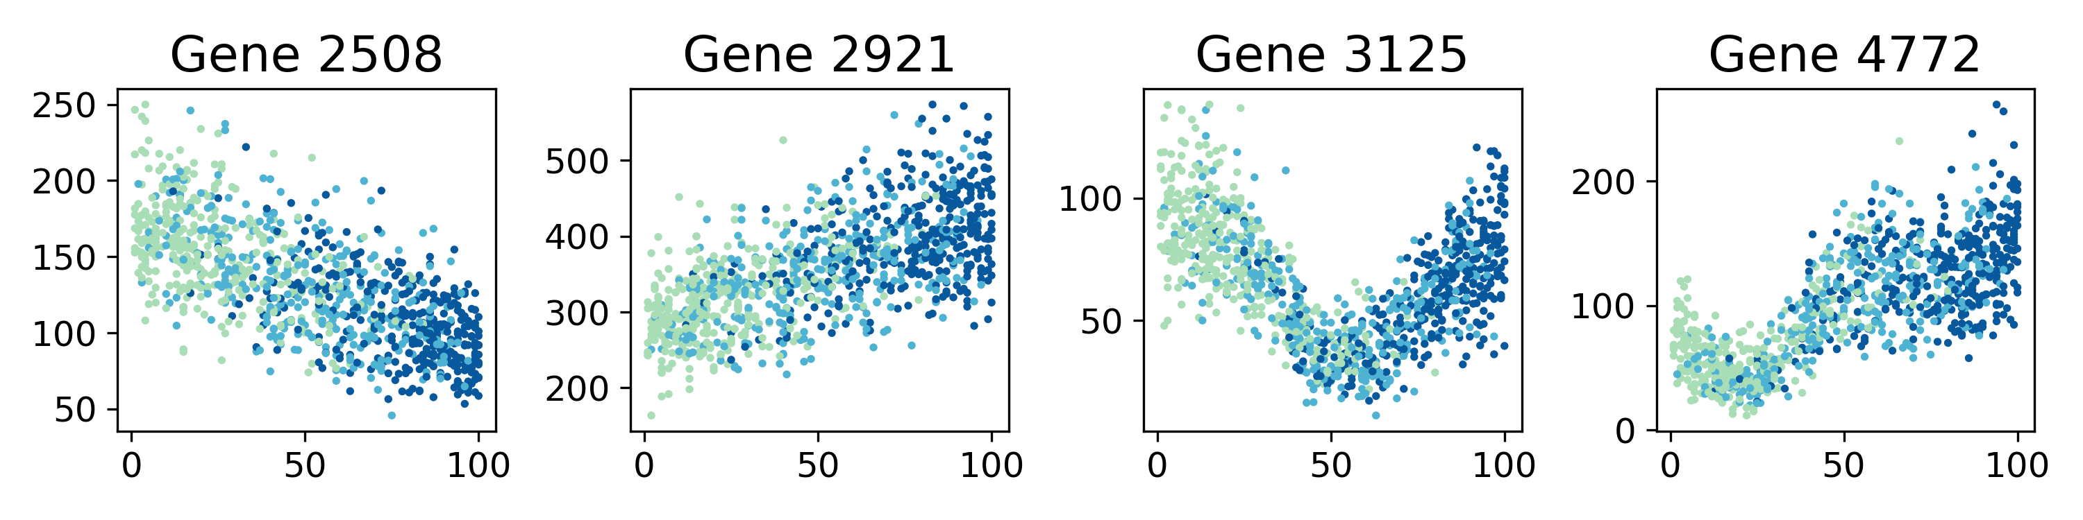
Pseudotime facilitates analysis of genes driving cellular progression
Ordering
Sample
Pseudotime
(graph walk)
Ground truth

Slide 12
Pseudotime facilitates analysis of genes driving cellular progression
Ordering
Sample
Pseudotime
(graph walk)
Ground truth

Slide 13
Pseudotime facilitates analysis of genes driving cellular progression
Ordering
Sample
Pseudotime
(graph walk)
Ground truth

Slide 14
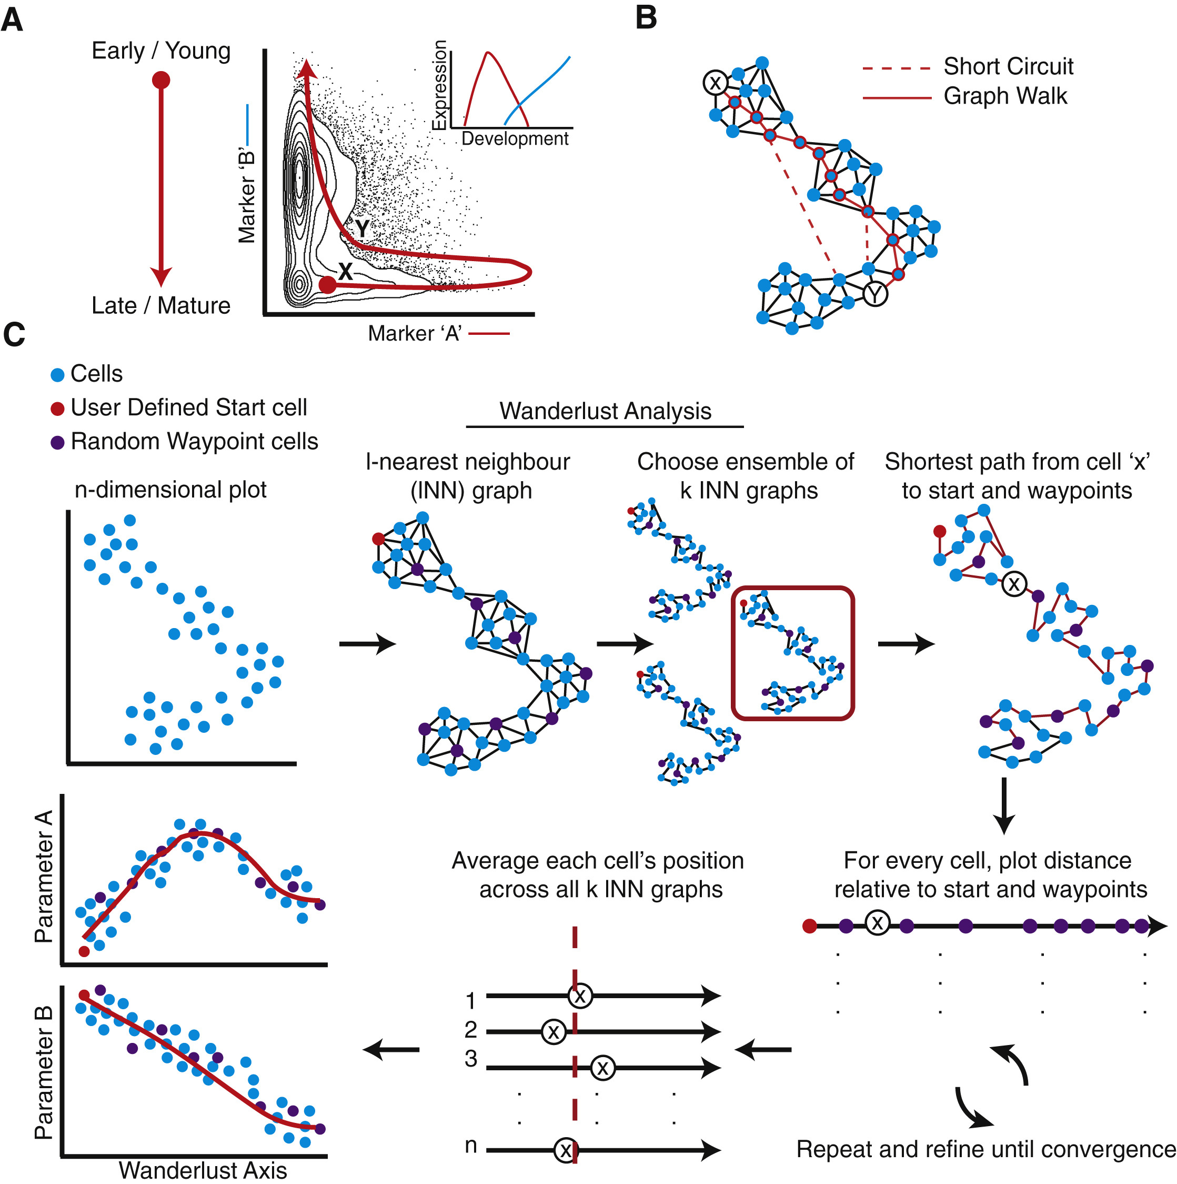
Wanderlust – Bendal et al. (2014)
Pseudocode
User selects a ”start cell”
Randomly select n “waypoints”
Learn a set of k-NN graphs
For each graph:
For each cell:
Calculate walk distance to the start cell
Calculate walk distance to waypoints
Calculate each cell’s relative position to start and endpoints
Average across all k-NN graphs

Slide 15
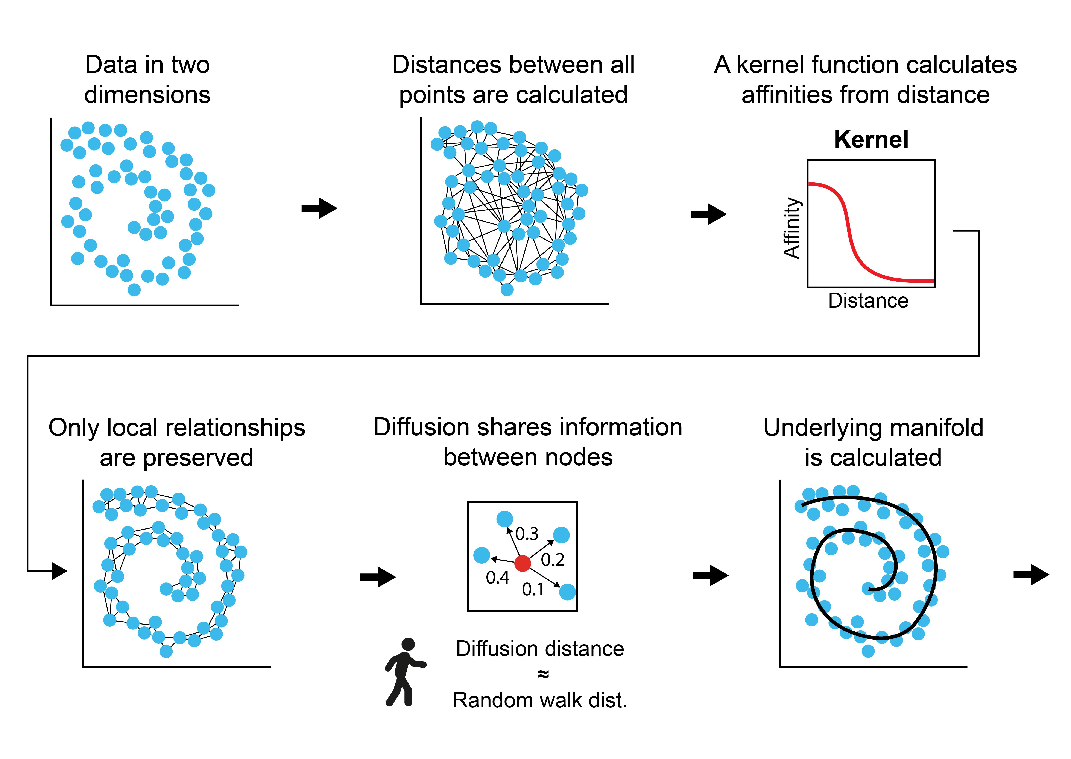
Diffusion pseudotime – from graph distance to random walks

Slide 16
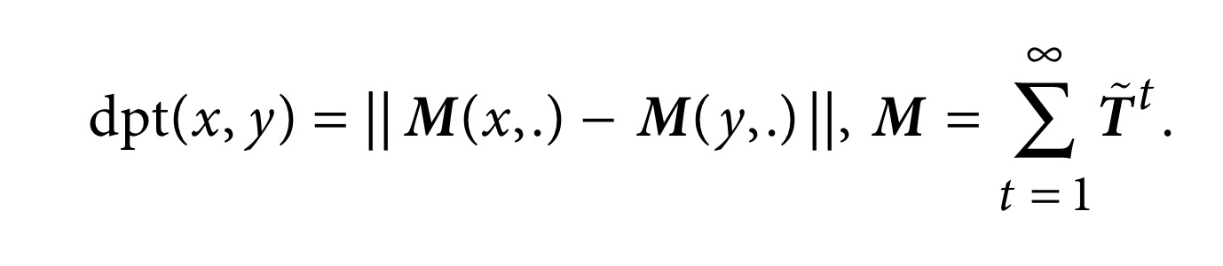
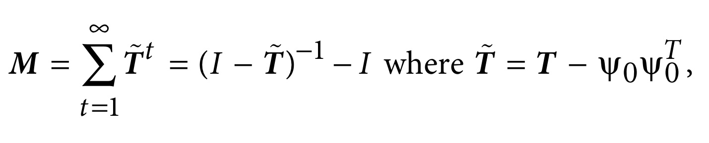
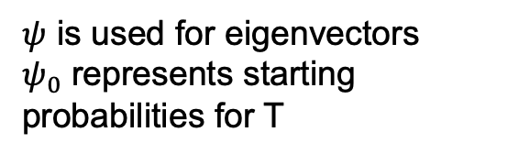
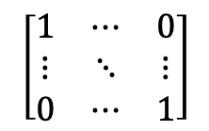
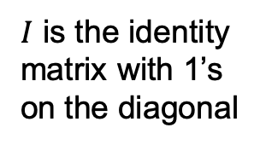
Diffusion pseudotime – from graph distance to random walks
Euclidean distance between two vectors
Sum over values of t
$ψ$ is used for eigenvectors
$ψ_{0}$ represents starting probabilities for T
Provides a calculatable solution to the infinite series
T is the random walk matrix
$I$ is the identity matrix with 1’s on the diagonal
$$\left[\begin{matrix}1 & ⋯ & 0 \\ ⋮ & ⋱ & ⋮ \\ 0 & ⋯ & 1\end{matrix}\right]$$

Slide 17
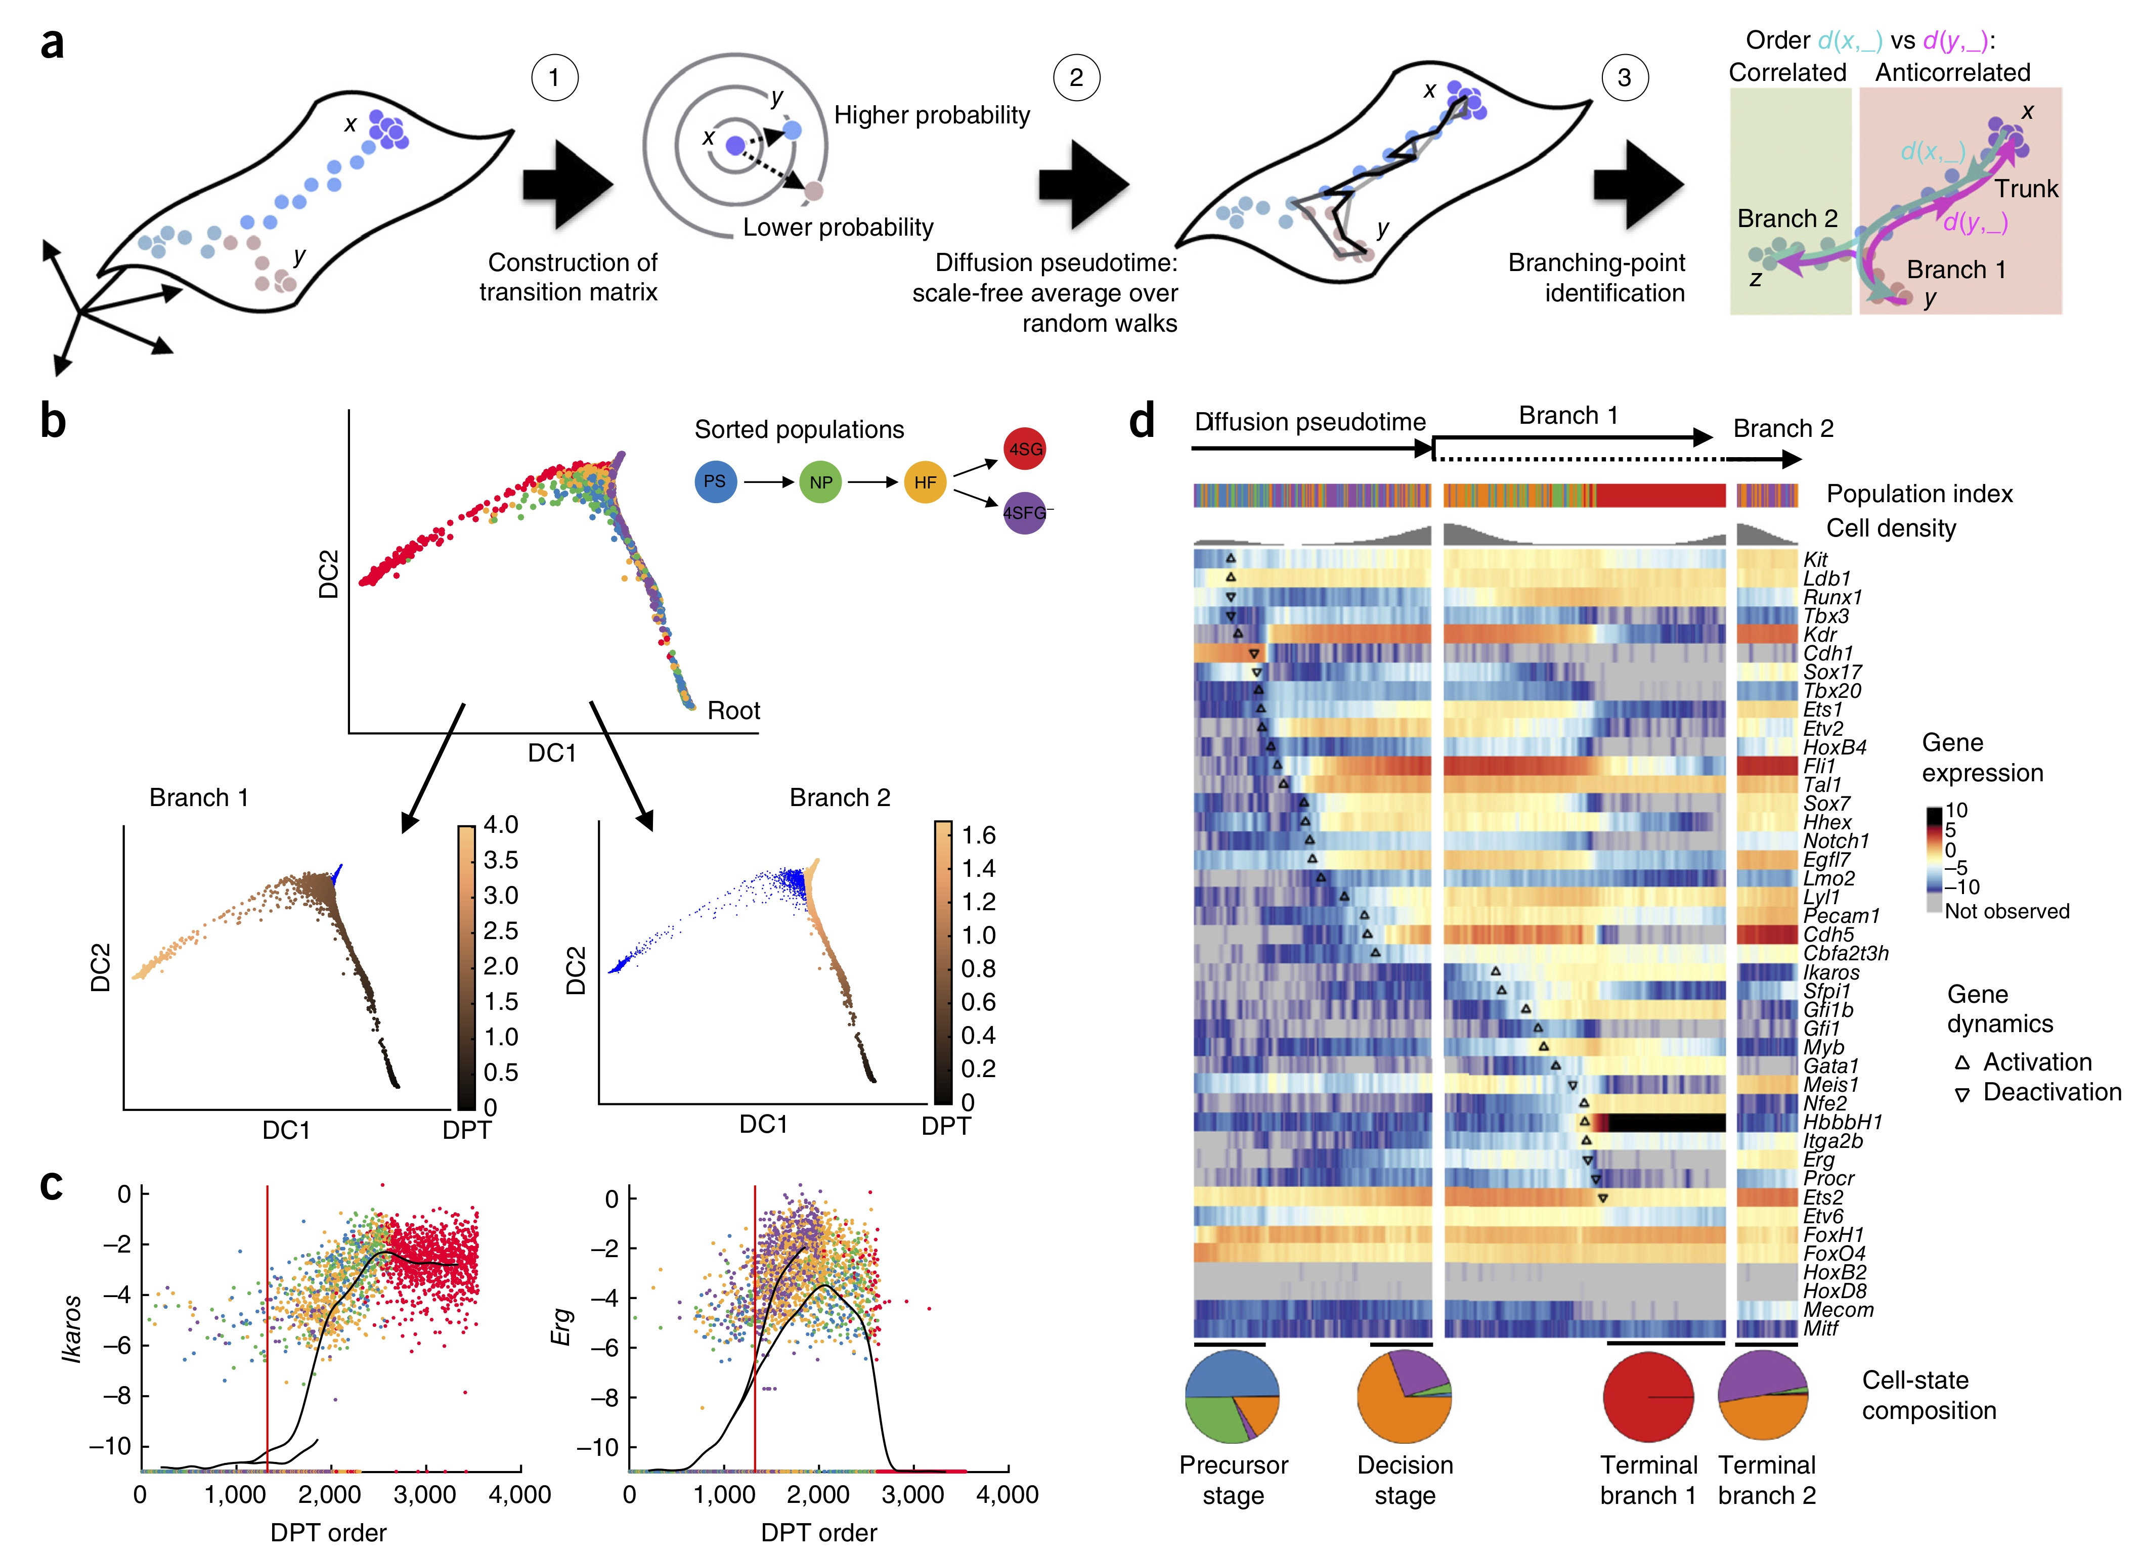
Diffusion pseudotime – from graph distance to random walks
Euclidean distance between two vectors
Sum over values of t
Transition probabilities give data geometry
Provides a calculatable solution to the infinite series
Correlation reveals branches

Slide 18
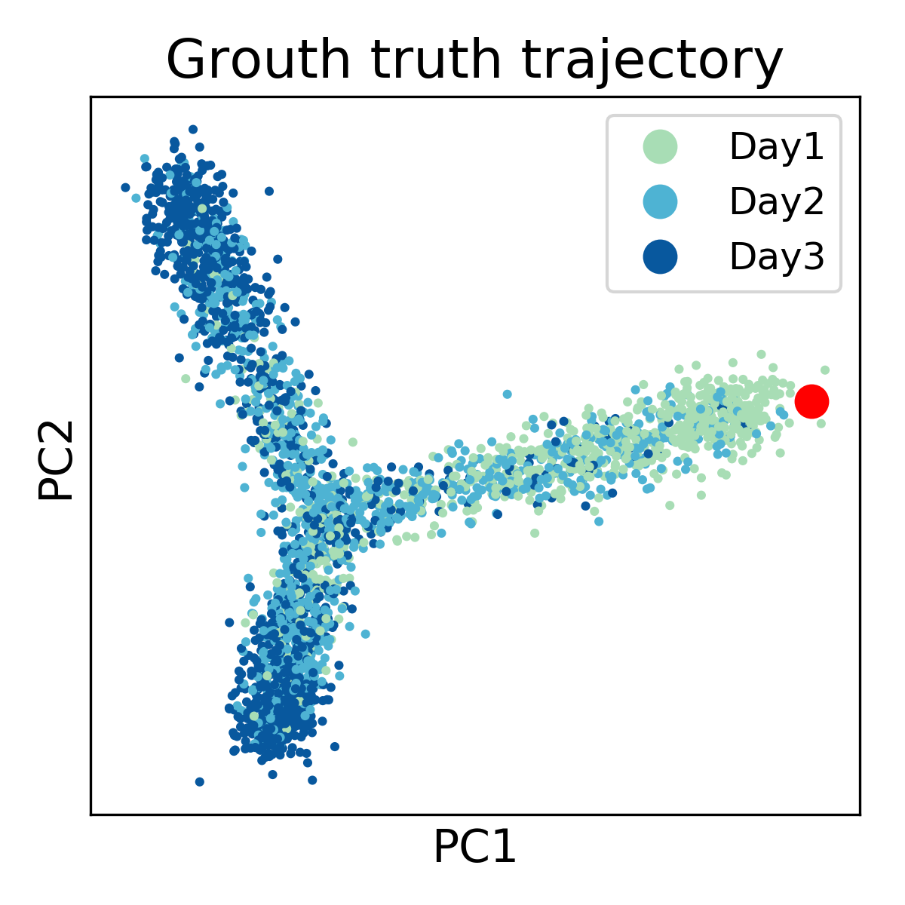
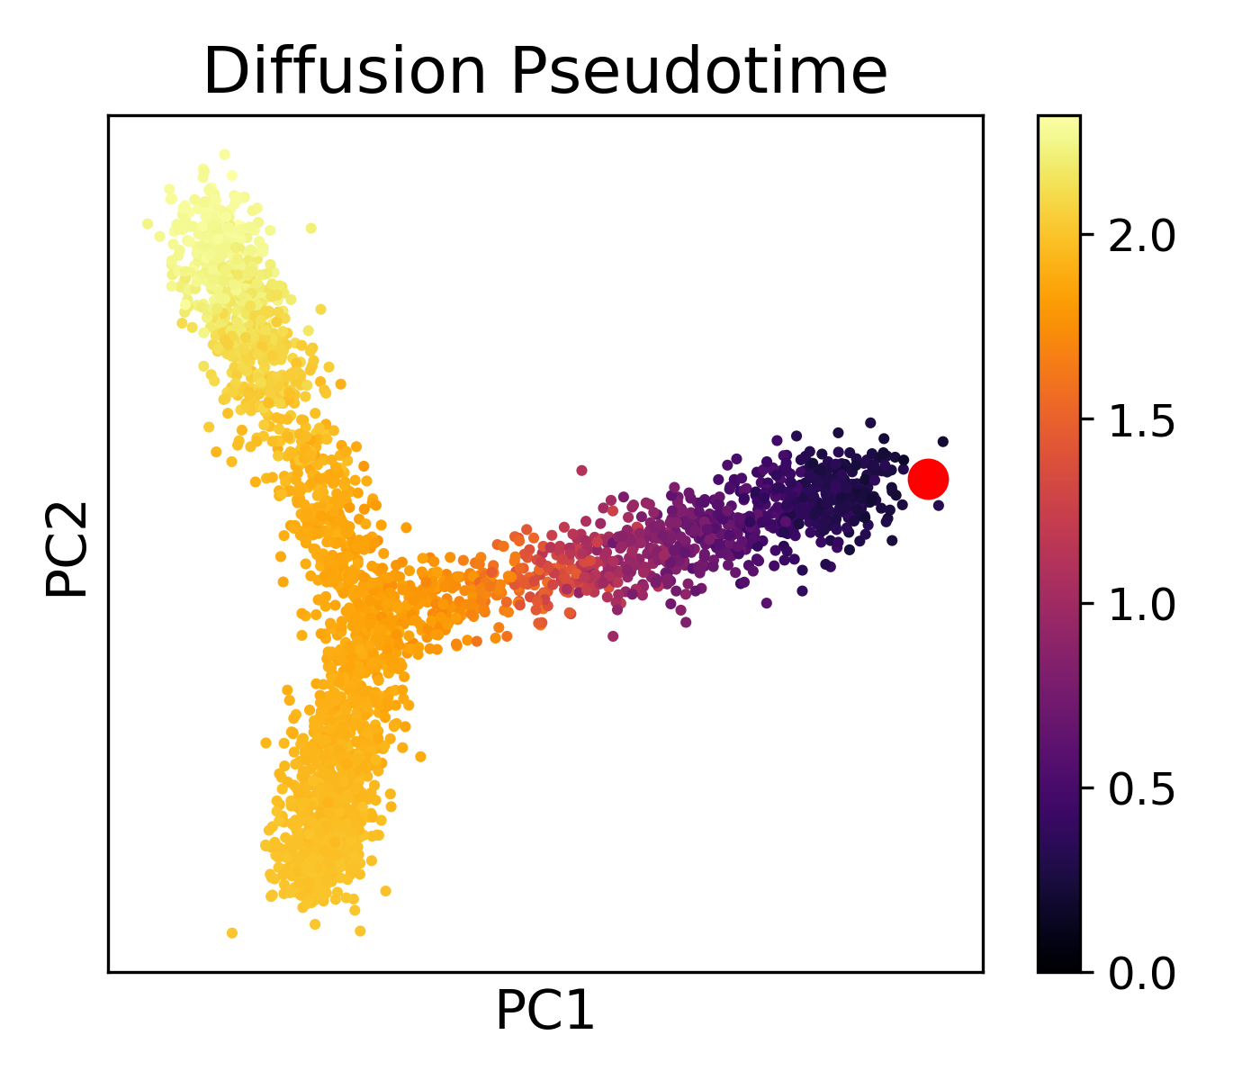
Using DPT to detect branches
User-defined root cell

Slide 19
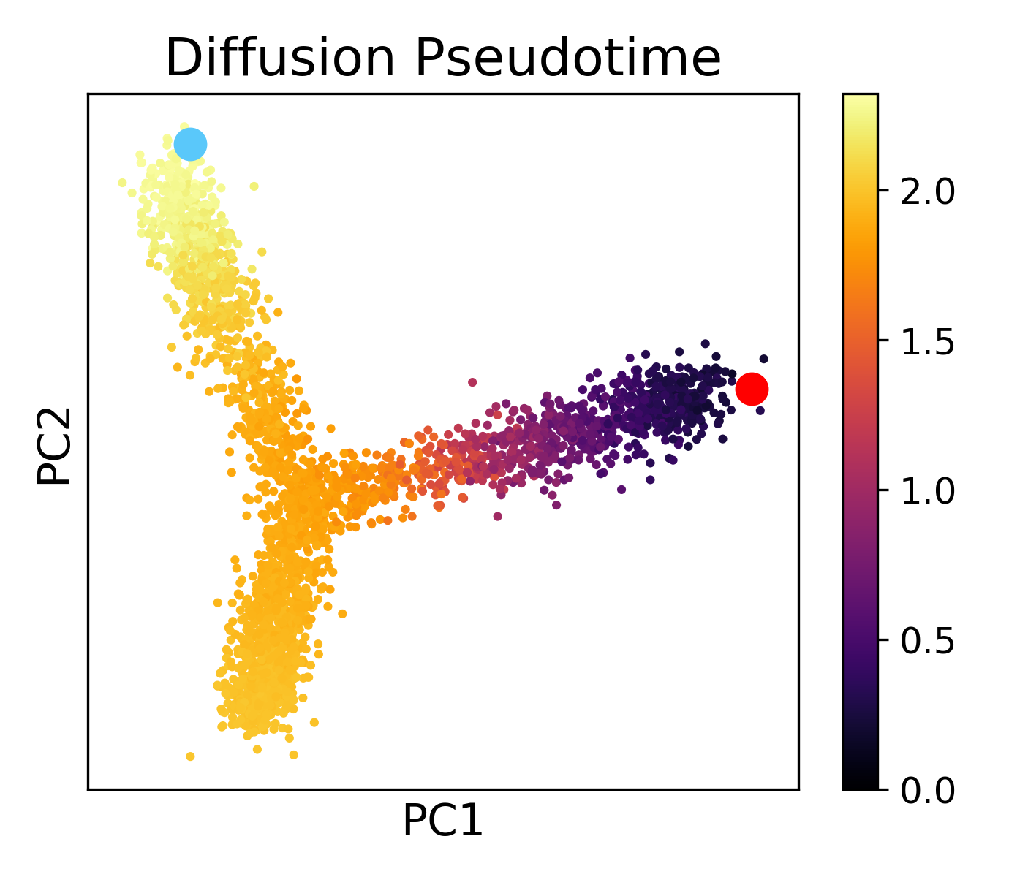
Using DPT to detect branches
Maximally distant cell

Slide 20
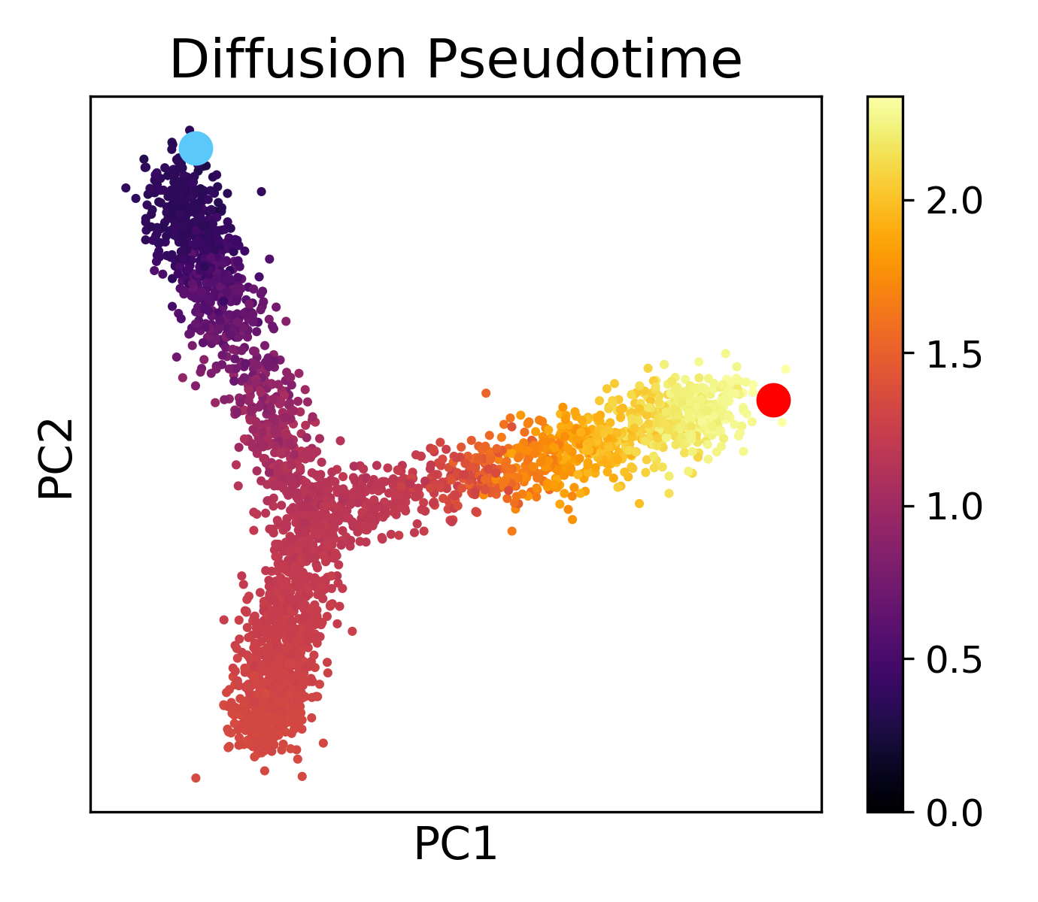
Using DPT to detect branches
DPT(root , x)
DPT(end , x)
“Forward pseudotime”
“Backward pseudotime”

Slide 21
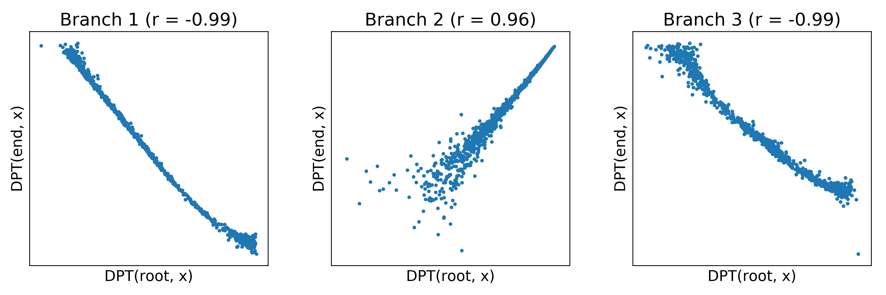
Using DPT to detect branches
DPT(root , x)
DPT(end , x)
Cells on the same “branch” as the root and end cell have negative DPT correlation.
Cells on different branches have positive DPT correlation
“Forward pseudotime”
“Backward pseudotime”

Slide 22
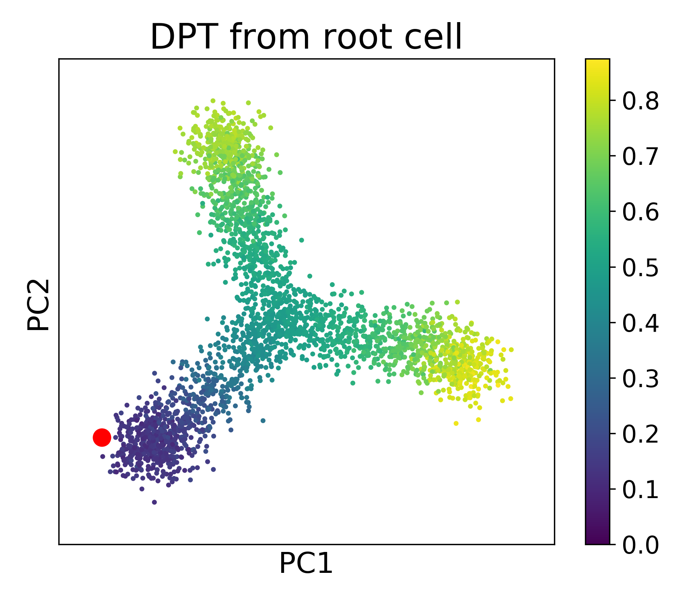
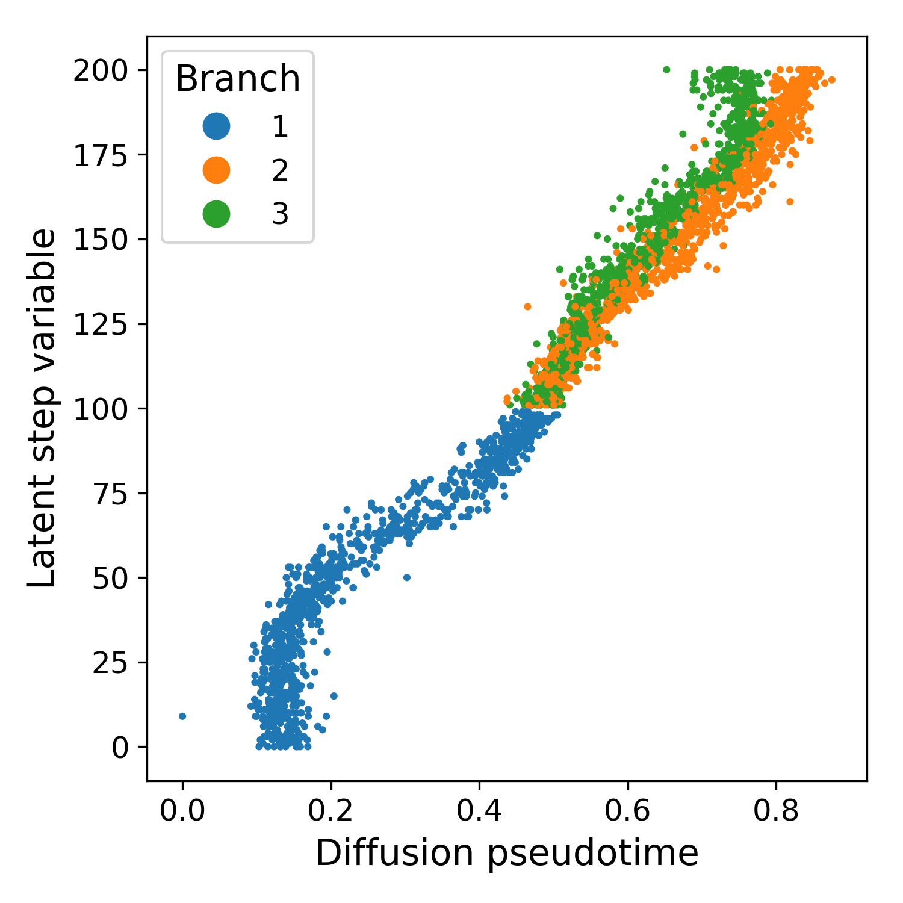
Exercise – Run diffusion pseudotime from scratch

Slide 23
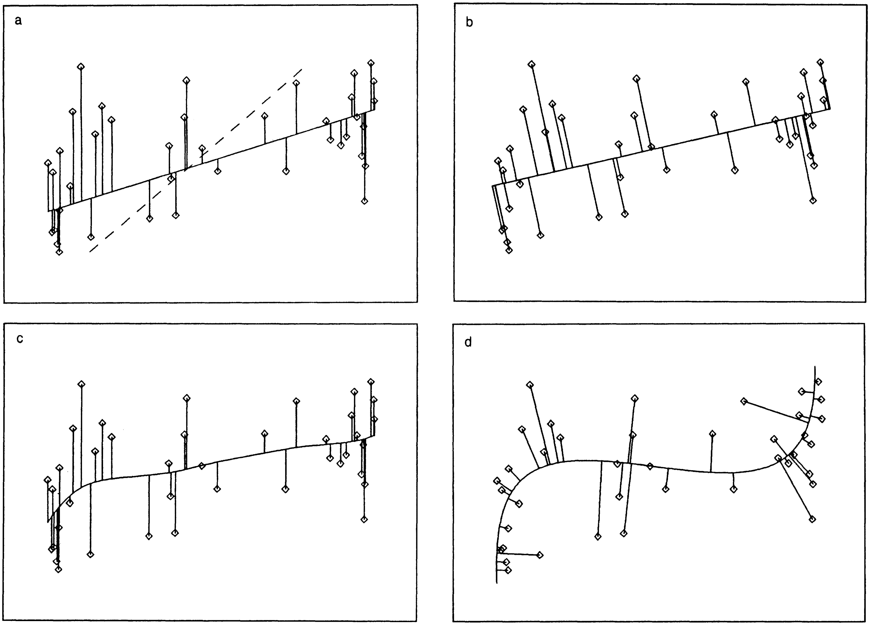
Principal curves – non-linear PCA
Linear Regression
PCA
Non-linear Regression
Principal Curves
Hastie and Stuetzle, 1989

Slide 24
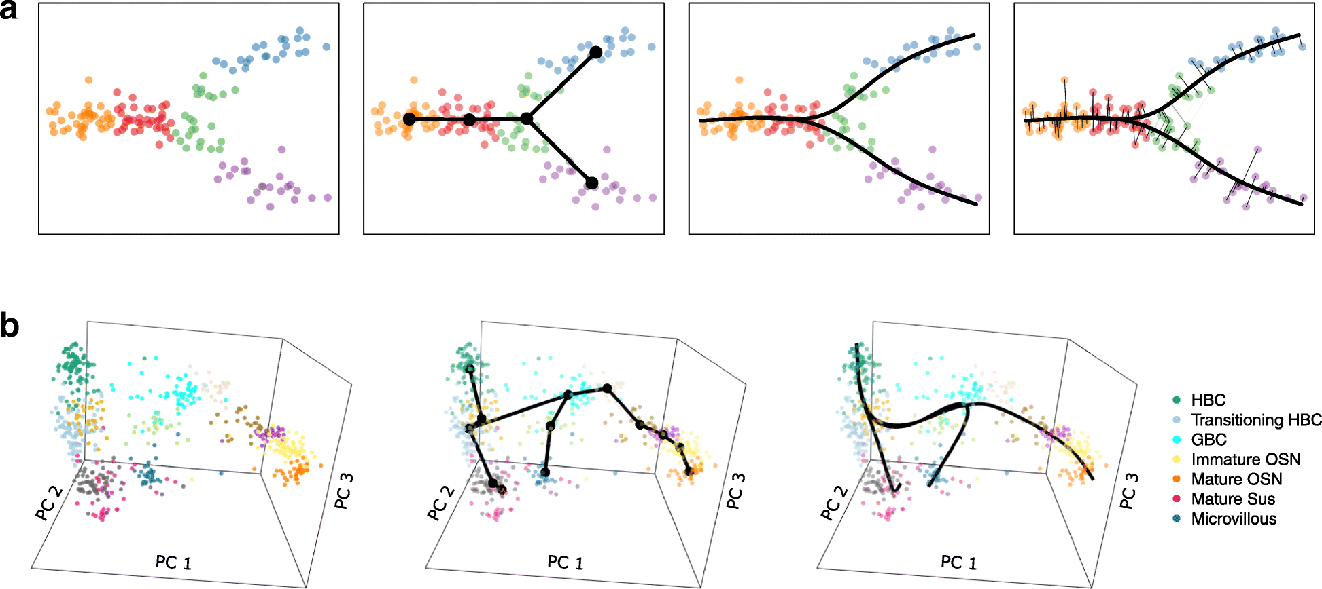
Slingshot - Street et al. 2018
2. Cluster &
Minimum Spanning Tree
1. Dimension-reduced data
3. Fit principal curves
4. Project data onto principal curves

Slide 25
Exercise: Compare Slingshot and Diffusion Pseudotime on MEFs

Slide 26
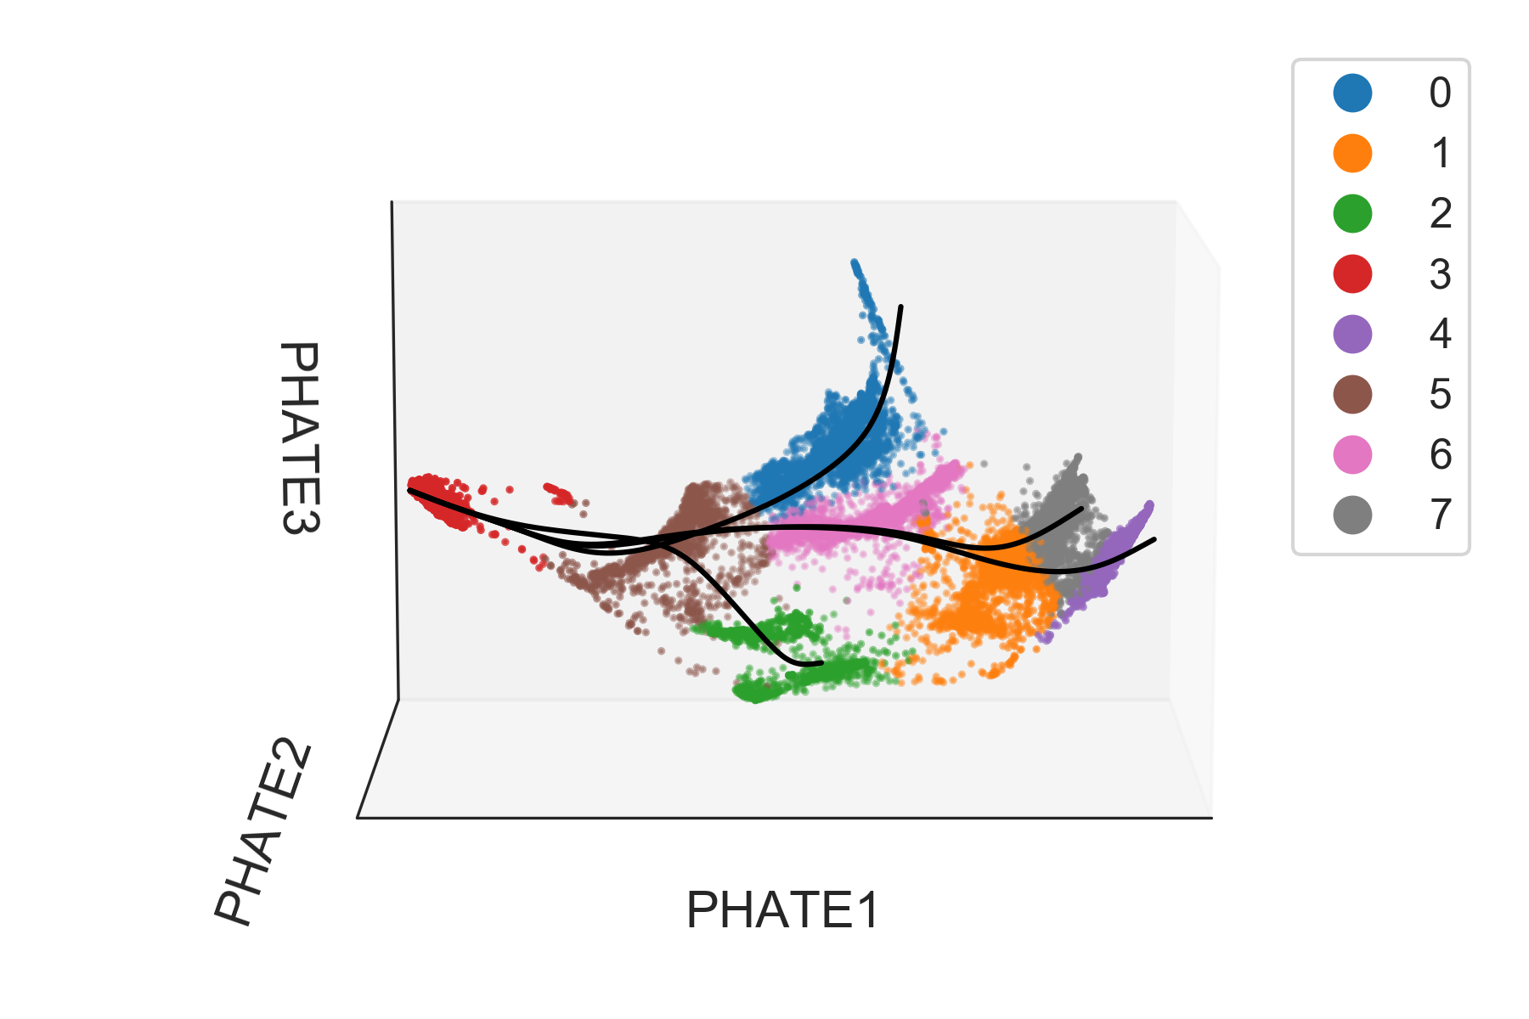
Exercise: Apply Slingshot to EB data

Slide 27
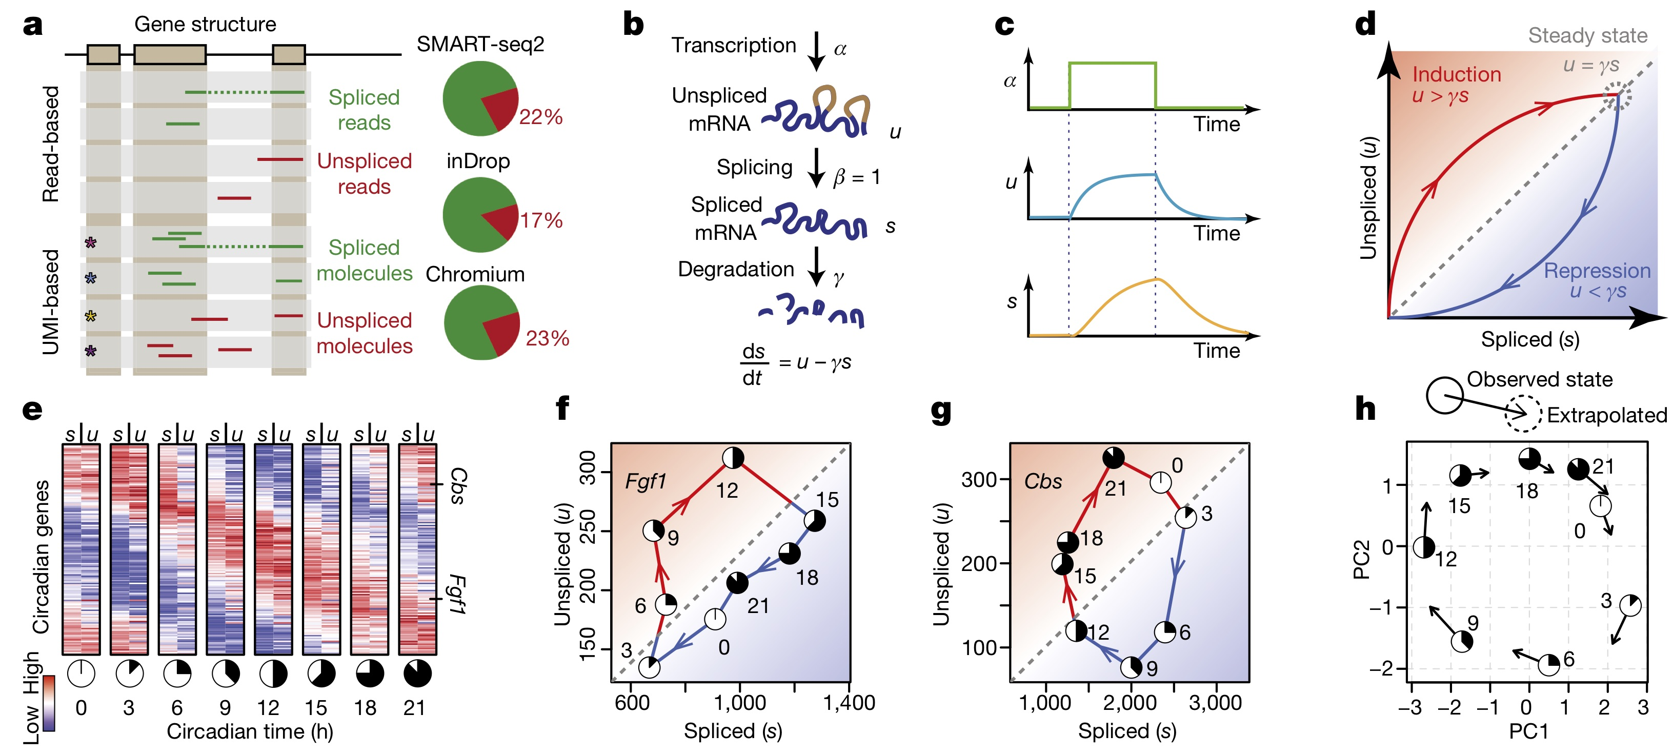
RNA Velocity: using gene splicing genes to infer future cell state
Le Manno, et al. Nature. 2018.

Slide 28
RNA Velocity: using gene splicing genes to infer future cell state
Le Manno, et al. Nature. 2018.

Slide 29
RNA velocity correctly infers circadian rhythm in mouse liver
mRNA was measured in bulk over 24 hours in the mouse liver

Slide 30
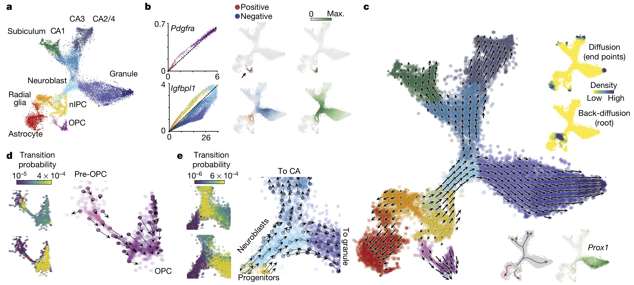
Neural fate decisions in the mouse hippocampus
CA3
Subiculum
CA1
Neuroblast
Granule
Radial
glia
nIPC
Astrocyte
OPC

Slide 31
Neural fate decisions in the mouse hippocampus
CA3
Subiculum
CA1
Neuroblast
Granule
Radial
glia
nIPC
Astrocyte
OPC

Slide 32
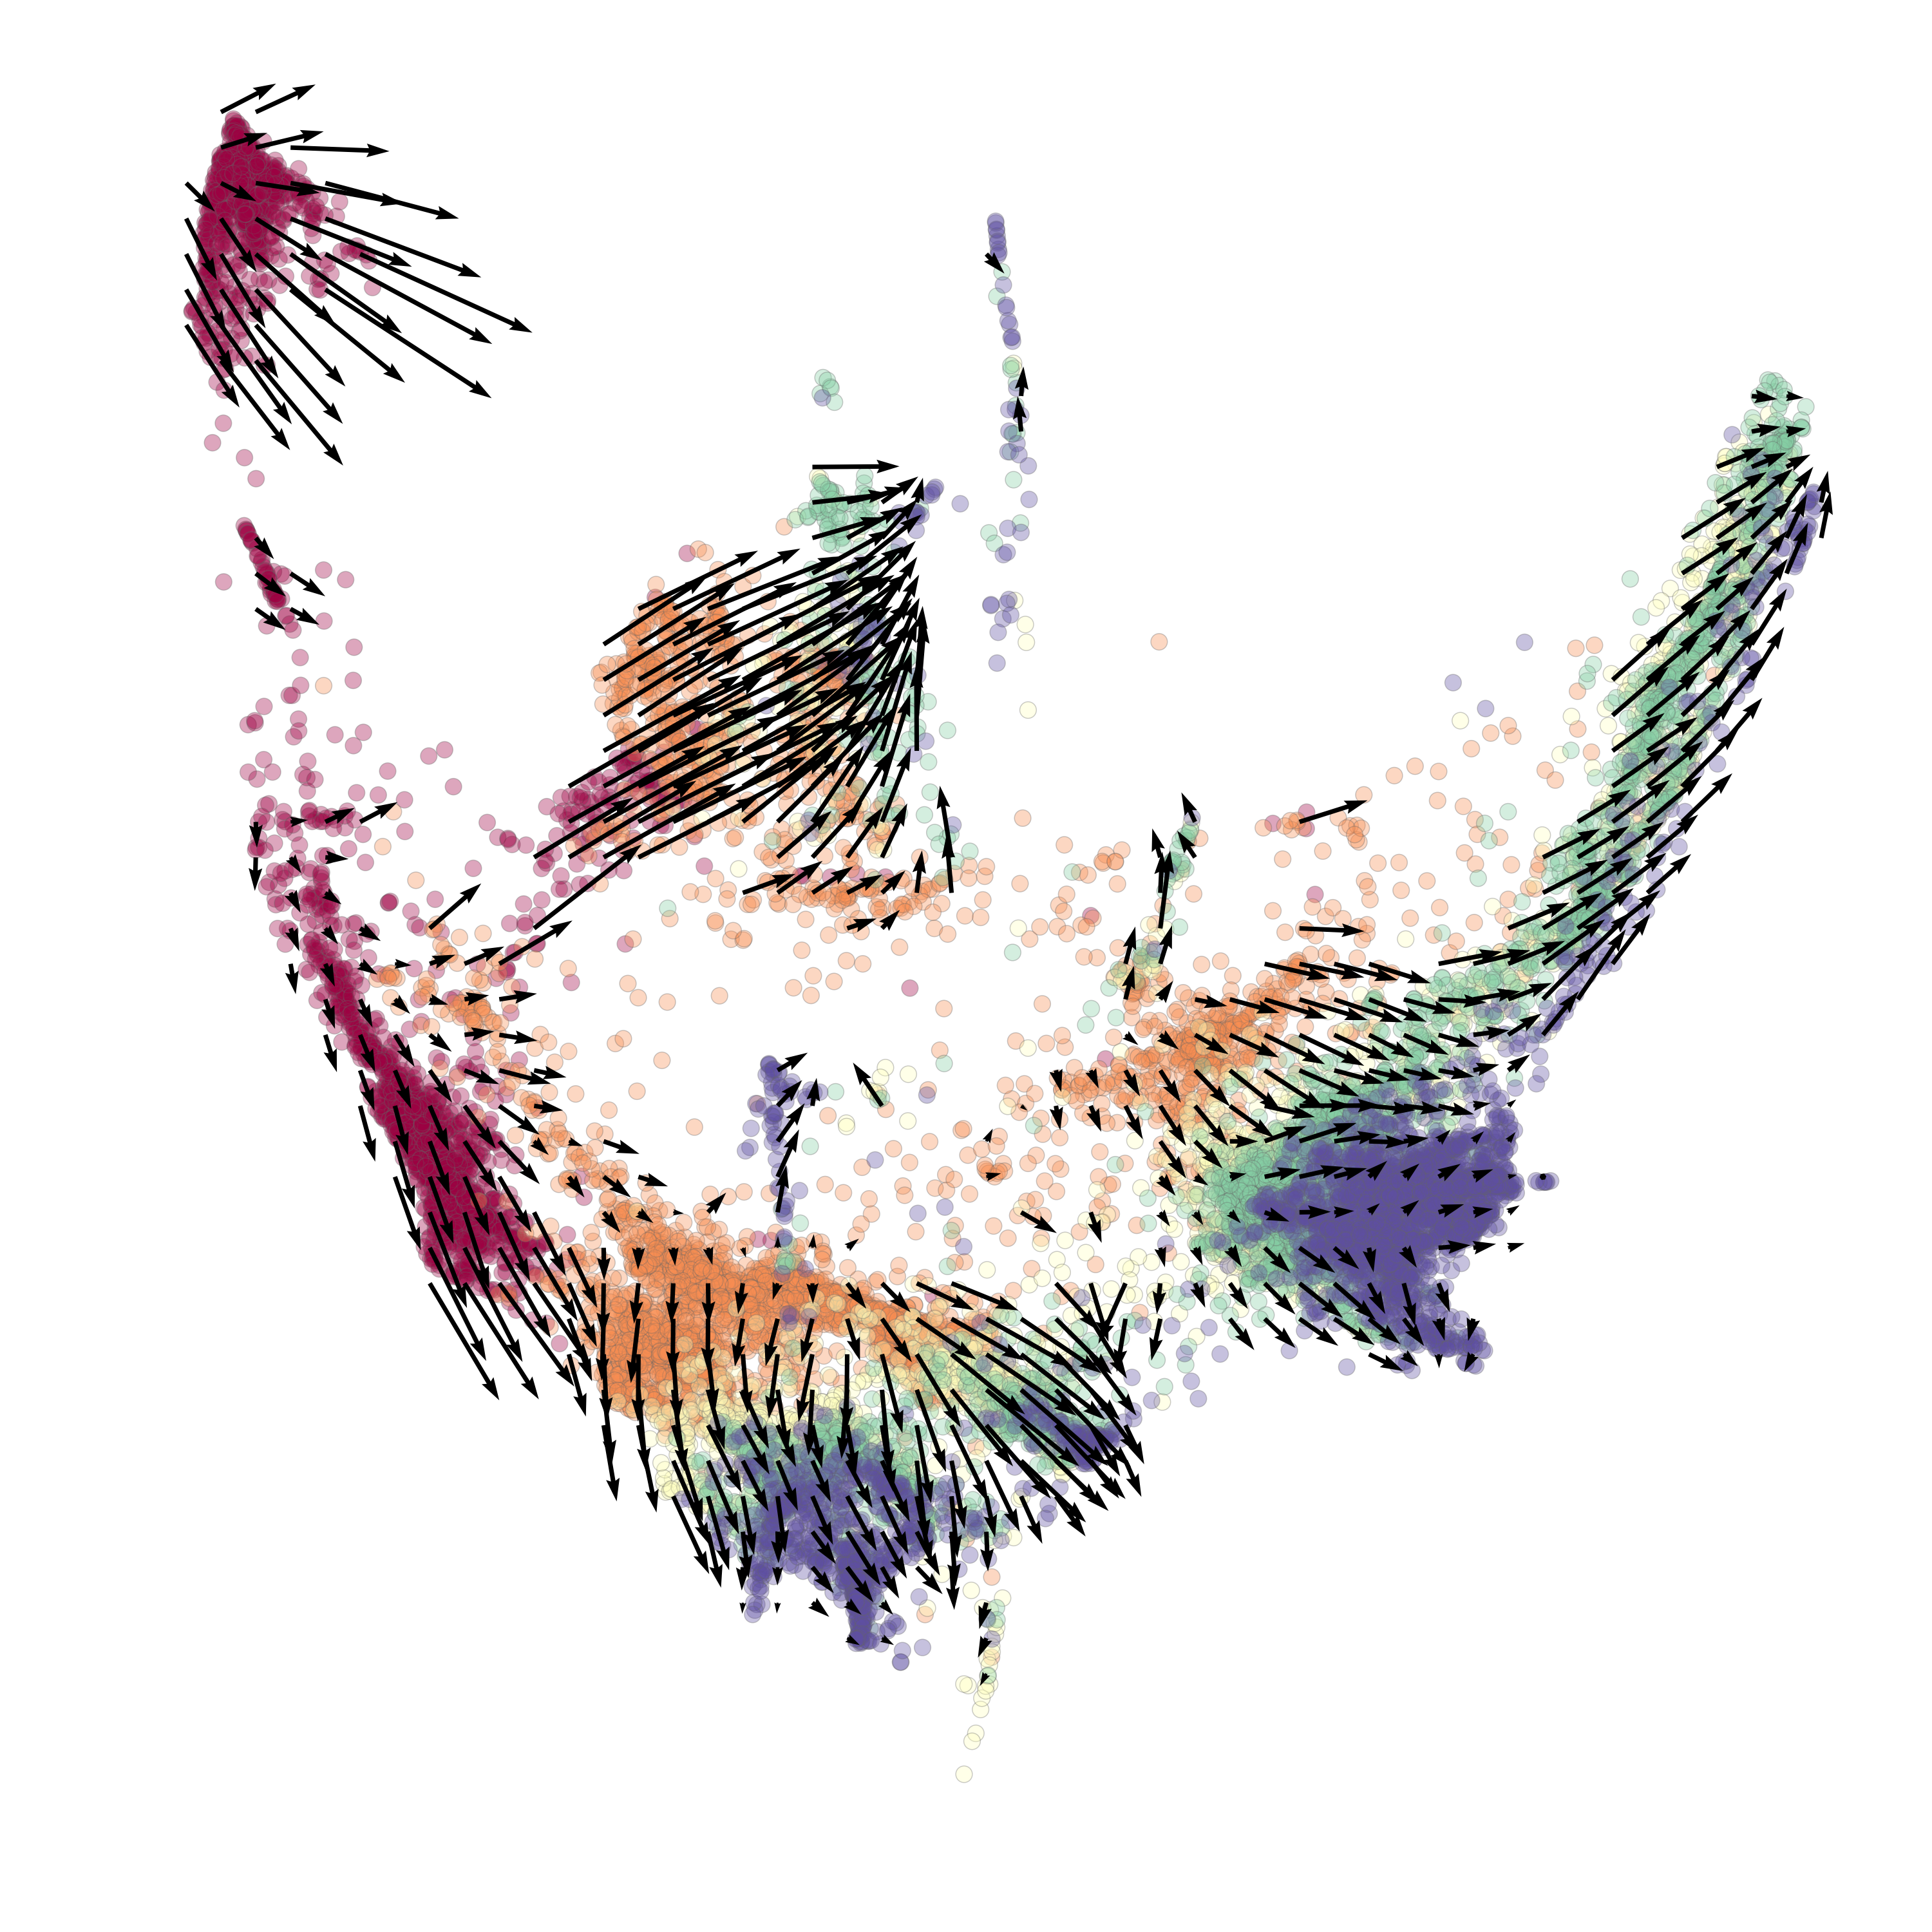
Exercise: RNA velocity on EB data

